Slide 1
Lesson 9.7
Goal: The learner will identify dilations.

Slide 2
Dilation
Enlargement or Reduction
Scale factor is k
$k=\frac{CR^{′}}{CR}, k≠1$
k > 1, enlargement
0<k<1, reduction
R’
R
C
Center of Dilation

Slide 3
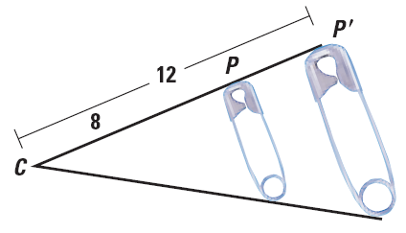
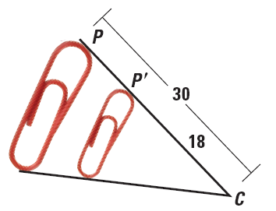
Find the scale factor
a.
b.

Slide 4
Enlargement or Reduction?
In dilation, CP’=3 and CP = 12. Tell whether the dilation is a reduction or an enlargement and find the scale factor.

Slide 5
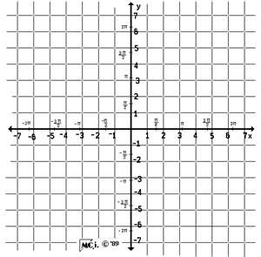
Dilation on the grid
The vertices of KLMN are K(-6,6), L(-3, 6), M(0, 3) and N(-6, 0). The scale factor is $\frac{1}{3}.$ Graph the image.
$(x,y)→(\frac{1}{3}x,\frac{1}{3}y)$

Slide 6
Composition
The vertices of $ΔABC$ are A(-4, 1), B(-2, 2) and C(2,1). Find the image after the following transformations.
Translation: $(x,y)→(x+5, y+1)$
Dilation: (x, y)$→$(2x, 2y)

Slide 7
Assignment
P.629 #3-6, 21-24,33-35

