Slide 1
Lesson 9.6
Goal: The learner will identify line and rotational symmetry.

Slide 2
Line symmetry
When you can map a figure onto itself by a line of reflection.
Line of symmetry: the line of reflection.

Slide 3
How many lines of symmetry?
a.
c.

Slide 4
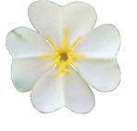
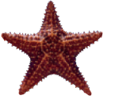
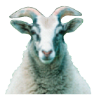
How about these?
1.
2.
3.

Slide 5
Draw a hexagon with no lines of symmetry.

Slide 6
Rotational Symmetry
A figure can be mapped onto itself by a rotation of 180˚ or less.
Center of symmetry: the point the rotation centers around.

Slide 7
Identify Rotational Symmetry

Slide 8
How to measure rotational symmetry.
Divide 360˚ by the number of lines of symmetry.
This is the smallest angle of rotation.
Multiples of this angle up to 180˚ are the other angles of rotation.

Slide 9
Assignment
P. 621 #1-15, 27-30, 34

