Slide 1
Lesson 9.5
Goal: The learner will classify quadrilaterals by their sides and angles.

Slide 2
Quadrilateral: closed figure with four segments called sides.
Quadrilateral | Diagram
Parallelogram: 2 pairs of parallel sides
Rectangle: 4 right angles, also a parallelogram
Rhombus: 4 equal sides, also a parallelogram
Square: 4 equal sides and 4 right angles, also a parallelogram

Slide 3
True? Or False?
All squares are rectangles.
Some rhombuses do not have 2 pairs of parallel sides.

Slide 4
Another way to look at it.
Quadrilaterals
Parallelograms
Rectangle
Rhombus
Square

Slide 5
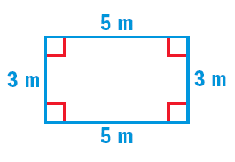
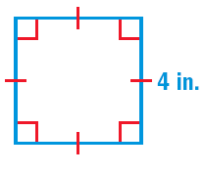
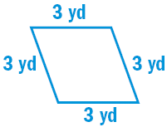
Classify the parallelograms as many ways as possible.

Slide 6
Draw a quadrilateral that is a rectangle but not a square.

Slide 7
Draw a parallelogram that is neither a rectangle nor a rhombus.

Slide 8
Sum of the angles in a quadrilateral is 360˚.
140˚
54˚
50˚
x˚

Slide 9
Assignment
P. 482 # 1-19
Challenge #35

