Slide 1
Lesson 9.4
Goal: The learner will rotate figures about a point.

Slide 2
Rotation
A transformation that a preimage turns around a fixed point.
Center of Rotation: fixed point preimage turns around.
Angle of Rotation: angle formed with preimage and image
Rotation is an isometry.

Slide 3
Angle of rotation
P
Center of rotation

Slide 4
Rotation
Clockwise
Counterclockwise

Slide 5

Draw 120˚ rotation of $Δ$ABC about P.
Steps
Draw a segment from P to A.
Draw a ray to form 120˚ angle with $\overline{PA}$
Draw A’ so that PA = PA’
Repeat for B and C.
A
C
B
P

Slide 6
Rules to Rotate By
Clockwise 90˚: (-b, a)
Clockwise 180˚: (-a, -b)
Clockwise 270˚: (b, -a)
Counterclockwise 90˚: (b, -a)
Counterclockwise 270˚: (-b, a)

Slide 7
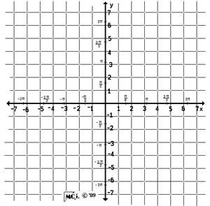
Let’s do this.
Rotate $ΔABC$clockwise 90˚, A(1,1), B(2, -1) and C(3, 1)
Rotate $ΔABC$
counterclockwise 90˚

Slide 8
Rotate $\overline{AB}$180˚ , A( 1, -1) and B (-2, 3)

Slide 10
Assignment
P. 602 #6-9, 12, 13, 21,23

