Slide 1
Lesson 9.3
Goal: The learner will reflect a figure in any given line.

Slide 2
Reflection
A transformation that uses a line to create a mirror to reflect the image.
Line of Reflection: the line preimage is reflected over.
It is an isometry
P
c
c
P’

Slide 3
Possible Reflections
P
P’
P
P’
Q’
Q
Q
Q’
P’
P
Q’
P’
P
Q
Q’
Q

Slide 4
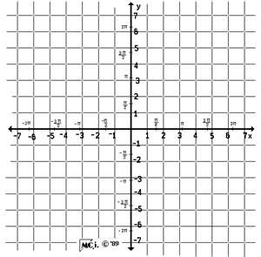
The vertices of $ΔABC$ A(1,3), B(5, 2) and C(2,1)
Reflect over x = 3

Slide 5
The vertices of $ΔABC$ A(1,3), B(5, 2) and C(2,1)
Reflect over y = 1

Slide 6
Reflection Rule
Reflect over x-axis: (a, -b)
Reflect over y-axis: (-a, b)
Reflect over y = x: (b, a)
Reflect over y = -x: (-b, -a)

Slide 7
Reflect over y = x.
$\overline{FG}$ , F(-1, 2) and G(1, 2)

Slide 8
Example Time
Reflect F(-1, 2) and G(1, 2) over y = -x

Slide 9
Assignment
P. 593 #3-5, 9, 10, 15, 22

