Slide 1
Lesson 9.1
Goal: The learner will use a vector to translate a figure.

Slide 2
Vocabulary
Preimage: the original figure
Before
Name vertices or endpoints with capital letter, A
Image: the moved or changed figure
After
Name with original capital letter and apostrophe, A’

Slide 3
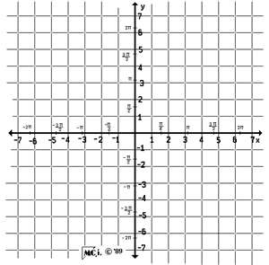
Check it out.
Graph ABCD with vertices A(-1,2), B(-1, 5), C(4, 6) and D(4, 2).
Find A’B’C’D’ by translating (x, y) $→$ (x + 3, y – 1)

Slide 4
How to write a translation rule.
Add/Subtract from x to move right/left
Add/Subtract from y to move up/down

Slide 5
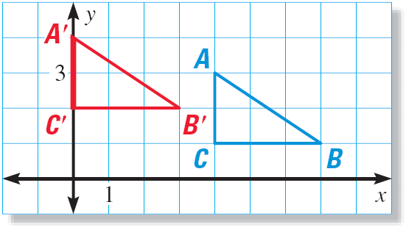
Isometry
Isometry: a transformation that preserves length and angle measures.
Preimage and image are congruent.
What’s the rule for the translation?
Is translation an isometry?

Slide 6
What’s your vector Victor?
Vector: a quantity that has direction and magnitude, or size.
Symbol: $\overset{⃑}{FG}$
Example
F is the initial point, or starting point.
G is the terminal point, or ending point
Component Form: $\overset{⃑}{FG}=\left\langle 4, 2\right\rangle$
G
2 units up
Vertical
component
F
4 units right
Horizontal component

Slide 7
Write the component form.
B
C

Slide 8
Translate This.
The vertices of $ΔABC$are A(0,3), B(2, 4) and C(1,0). Translate using $\left\langle 5, −1\right\rangle$

Slide 9
A boat heads out from point A on one island toward point D on another. The boat encounters a storm at B, 12 miles east and 4 miles north of its starting point. The storm pushes the boat off course to point C, as shown.
Write the component form of $\overset{⃑}{AB}$
Write the component form of $\overset{⃑}{BC}$
Write the component form of the path from C to D.

Slide 10
Assignment
P. 576 #3, 5, 7, 9, 12, 13, 15, 16, 18, 19, 28, 35, 36, 37

