Slide 1
Lesson 8.6
Goal: The learner will identify special quadritlaterals.

Slide 2
Quadrilateral Flowchart
Quadrilaterals
Parallelograms Trapezoids Kite
Isosceles trapezoid
Rectangle Rhombus
Follow the arrows to show what categories a quadrilateral can fit into.
Square

Slide 3
What is that thing?
Quadrilateral ABCD has at least one pair of opposite angles congruent. What type of quadrilaterals meet this condition?

Slide 5
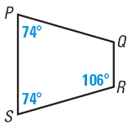
Trapezoid or not?
Is enough information given in the diagram to show that quadrilateral PQRS is an isosceles trapezoid? Explain.

Slide 6
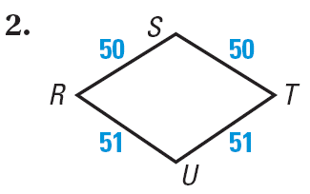
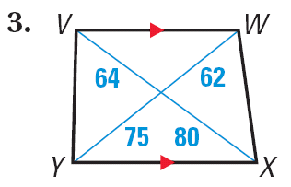
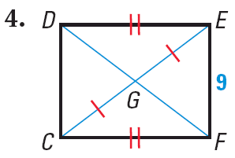
What is the most specific name for the quadrilateral?

Slide 7
One last question for you.
Quadrilateral DEFG has at least one pair of opposite sides congruent. What type of quadrilaterals meet this condition?

Slide 8
Assignment
P. 554 #3-16, 18-20
For the chart for #3-11, just number the row instead of writing down the property.

