Slide 1
Lesson 8.3
Goal: The learner will use properties to identify parallelograms.

Slide 2
Properties of Parallelograms
Opposite sides are congruent
Opposite angles are congruent
Diagonals bisect each other
If opposite sides of a quadrilateral are parallel and congruent, then it’s a parallelogram.

Slide 3
A little proof
B C
Given: $\overline{AB}≅\overline{CD} , \overline{BC}≅\overline{AD }$
Prove: ABCD is a parallelogram
A D
Statement Reason

Slide 4
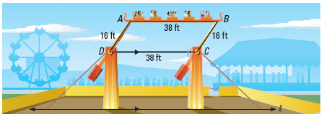
An amusement park ride has a moving platform attached to four swinging arms. The platform swings back and forth, higher and higher, until it goes over the top and around in a circular motion. In the diagram below, AD and BC represent two of the swinging arms, and DC is parallel to the ground (line l). Explain why the moving platform AB is always parallel to the ground.

Slide 5
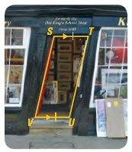
The doorway shown is part of a building in England. Over time, the building has leaned sideways. Explain how you know that SV = TU.

Slide 6
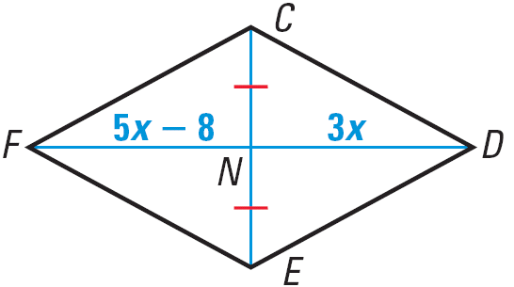
A little Algebra to lighten the mood.
For what value of x is quadrilateral CDEF a parallelogram?

Slide 7
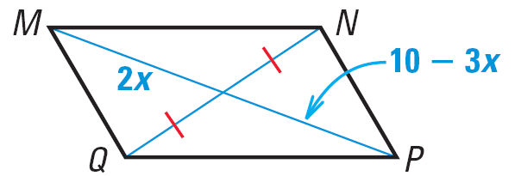
Last one
For what value of x is quadrilateral MNPQ a parallelogram? Explain your reasoning.

Slide 8
Assignment
P. 526 #3-10, 15, 19-21, 31

