Slide 1
Lesson 8.1
Goal: The learner will find angle measures in polygons.

Slide 2
Polygons
Closed figure, with segments as sides.
Diagonal: segment connecting two non-adjacent vertices.

Slide 3
Sum of Interior angles
n= # of sides
(n – 2) $∗$ 180˚
Example:
What is the sum of the angles of a pentagon?

Slide 4
Your turn!
Find the sum of the angles of an octagon.

Slide 5
Working it backwards
The sum of interior angles of a polygon is 900˚. How many sides are there in the polygon?

Slide 6
What’s my angle?
Find the value of x in the polygon.
108
121
x
59

Slide 7
Exterior angles
All the angles in a convex polygon sum to 360˚

Slide 8
Example

Slide 9
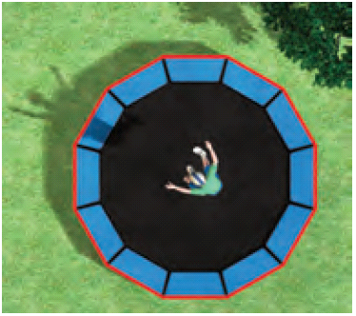
Last example, don’t be sad
The trampoline shown is shaped like a regular dodecagon. Find (a) the measure of each interior angle and (b) the measure of each exterior angle.

Slide 10
Assignment
P. 510 #3, 4, 7, 8, 11, 12, 14, 15, 18, 24, 25

