Slide 1
Lesson 7.6
Goal: The learner will use the sine and cosine ratios.

Slide 2
Sine and Cosine
B
hypotenuse
opposite
C
adjacent
A

Slide 3
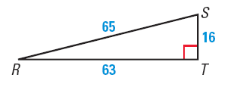
Find the Sine and Cosine Ratios
Find sin S and cos S.
What happens to the opposite and adjacent sides if I want to find sin R and cos R?

Slide 4
You Try It.
Find sin X and cos X.

Slide 5
How to use your calculator
Find sin 48°.
Find cos 78°

Slide 6
How to Remember the Ratios
What do you do when your foot hurts?
You “soh cah toa”

Slide 7
Find a missing side length.
Identify the information.
Decide if it’s sine or cosine.
Write the equation to solve.
R
25
57°
S
Q
x

Slide 8
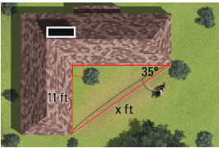
DOG RUN
You want to string cable to make a dog run from two corners of a building, as shown in the diagram. Write and solve a proportion using a trigonometric ratio to approximate the length of cable you will need.

Slide 9
Angle of Elevation
Angle formed with horizon and line of sight upwards.

Slide 10
Angle of Depression
Angle formed with horizon and line of sight downwards.

Slide 11
You are skiing on a mountain with an altitude of 1200 meters. The angle of depression is 21º. About how far do you ski down the mountain?

Slide 12
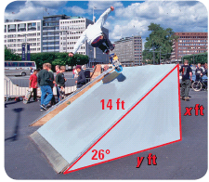
SKATEBOARD RAMP
You want to build a skateboard ramp with a length of 14 feet and an angle of elevation of 26°. You need to find the height and length of the base of the ramp.

Slide 13
Assignment
P. 477 #3, 6, 7, 10, 11, 13, 15, 19, 20, 34, 36

