Slide 1
Goal: The learner will use the tangent ratio for indirect measurement.
Lesson 7.5

Slide 2
Tangent Ratio
It is a ratio of sides that correspond to one of the acute triangles of a right triangle.
B
Opposite of A
Hypotenuse
C
A
Adjacent to A

Slide 3
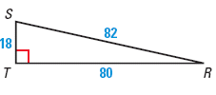
Finding the Tangent Ratios
Find the tan S and tan R.

Slide 4
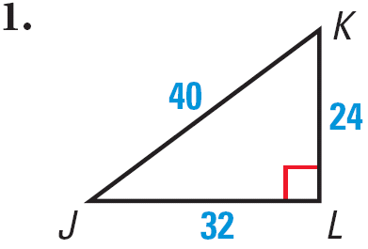
You Try it
Find tan J and tan K.

Slide 5
How to use your calculator
Make sure your calculator is in “degrees”
Press “tan” and type in 35° and hit enter.
Find tan 80°.

Slide 6
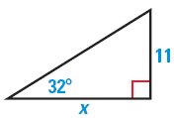
Finding a missing side length
If you know an angle and one side length you can find the other by setting up an equation.
Find x.

Slide 7
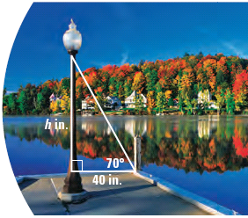
Find the height of a lamppost

Slide 8
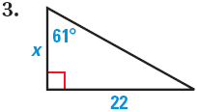
One For You.

Slide 9
Assignment
p. 469 #3, 4, 6-8, 13,14,18,19,21,27

