Slide 1
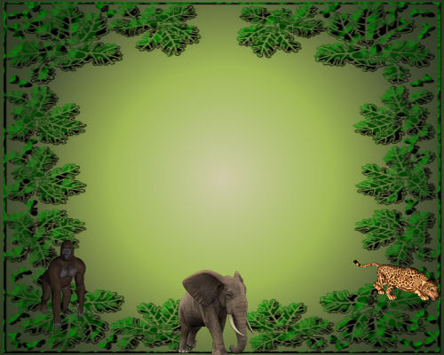
Lesson 4.7
Goal: The learner will us metric units of mass and capacity.

Slide 2
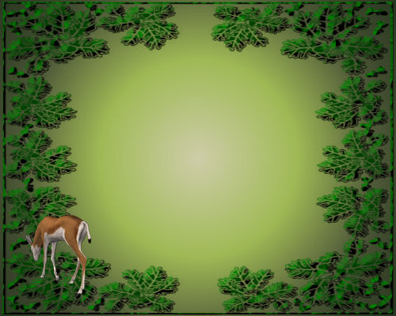
Mass
Mass of an object is the amount of matter it has.
Weight
Metric units of weight:
gram (g) : small like a paper clip
milligram (mg): a grain of sugar
kilogram (kg): a book

Slide 3
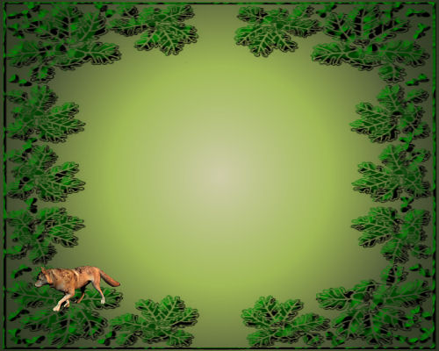
An item has a mass of 10.3 kilograms. Is it a dog or a pencil? Explain.

Slide 4
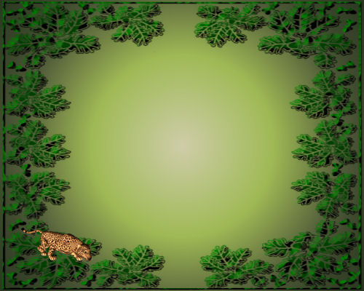
Capacity
Capacity measures how much a container can hold.
Volume
Metric units of capacity:
liter (L): a large bottle of water
milliliter (mL): an eyedropper
kiloliter (kL): about 5 bath tubs

Slide 5
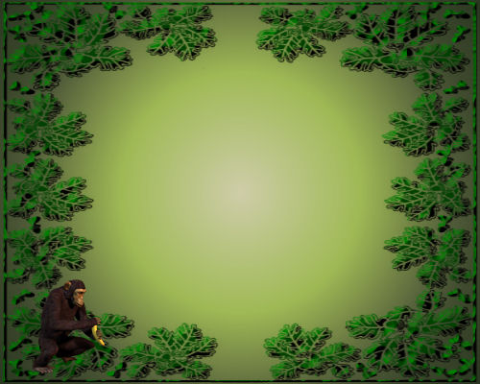
Tell whether the most appropriate unit to measure the capacity of the item is milliliters, liters or kiloliters
Bucket
teaspoon

Slide 6
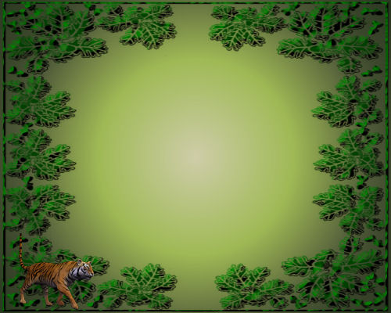
Choose an appropriate metric unit to measure the item.
Mass of an eraser
Capacity of a bottle of nail polish

Slide 7
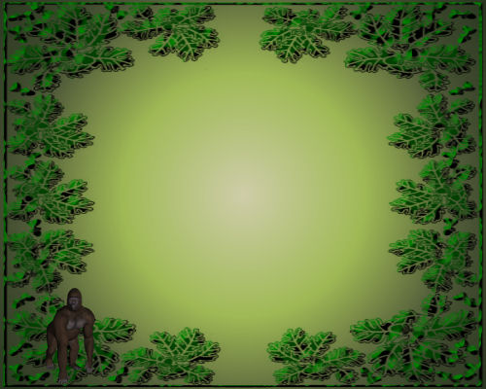
Assignment:
p. 205 # 1-5, 6-26 evens, 32, 33

