Slide 1
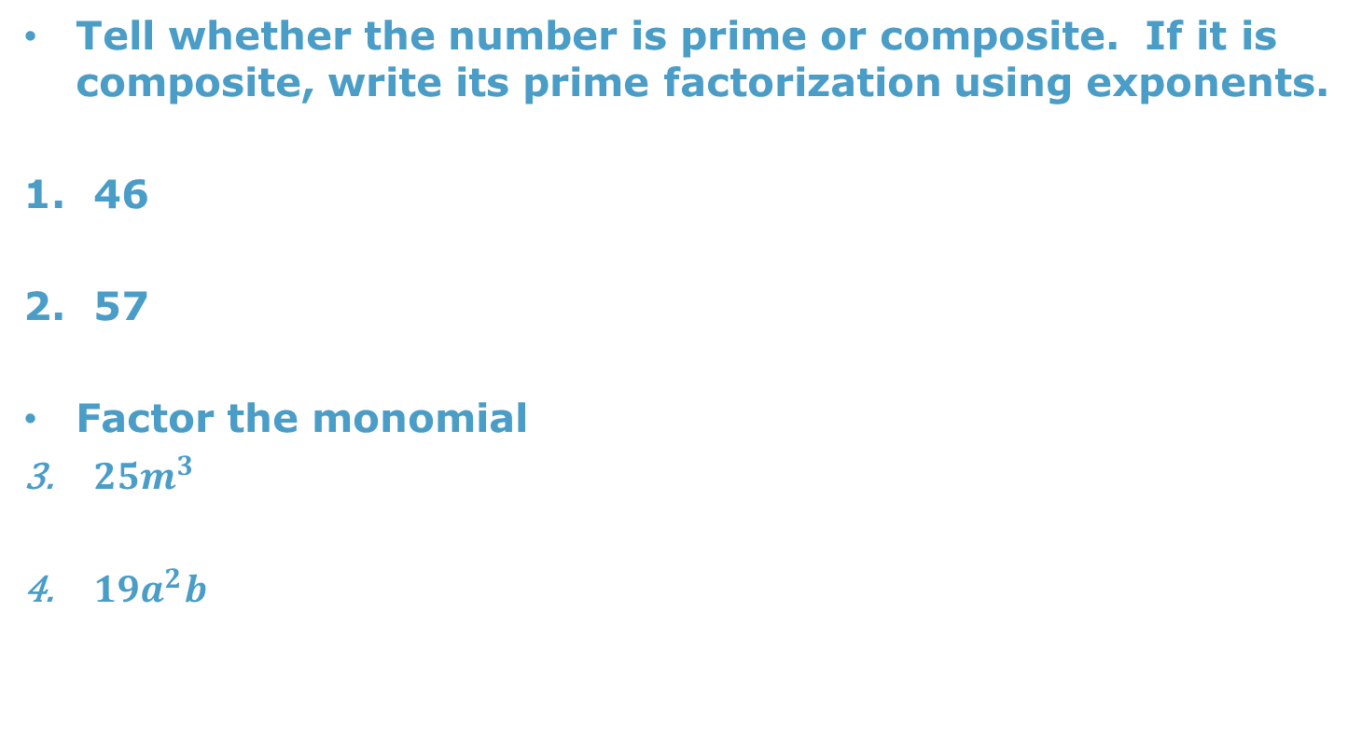
Warm Up
Tell whether the number is prime or composite. If it is composite, write its prime factorization using exponents.
46
57
Factor the monomial
$25m^{3}$
$19a^{2}b$

Slide 2
Lesson 4.2
Goal: The learner will find the GCF of two or more whole numbers.

Slide 3
Greatest Common Factor
Common Factor: a whole number that is a factor of two or more nonzero whole numbers.
  What does nonzero mean?
  Why can’t it be zero?
Greatest Common Factor: the largest whole number to be a factor of two or more numbers.

Slide 4
Try it, you’ll like it.
Method 1
12 and 30
Method 2
28 and 42

Slide 5
Let’s do this.
Method 1: Listing
  Great to use if the numbers are small.
List the factors of each number. Identify the largest that is on every list.
Example:
  Factors of 24: 1,2,3,4,6,8,12,24
  Factors of 60: 1,2,3,4,5,6,10,12,15,20,30,60
  Factors of 36: 1,2,3,4,6,9,12,18,36
Method 2: Prime Factoring
  Great for large numbers
Prime factor all the numbers. Identify all the common factors and multiply them.
Example:
64 144

Slide 6
Relatively Prime
Two numbers are relatively prime if their greatest common factor is 1.
Example: Are they numbers relatively prime?
  24 and 45
  35 and 54

Slide 7

GCF of Monomials
Find the GCF of the coefficients.
Write the variable part in expanded form.
Identify what’s in common.
Example: $18xy^{2}$ and $28x^{2}y^{2}$

Slide 8

Some More
$6x$ and $15x$
$32y^{2} and 6x^{2}y$
$7xy^{3} and 28xy^{2}$

Slide 9
Assignment
P. 179 #12, 18, 20, 22, 32, 37-45

