Slide 1
Warm Up
Write the decimal number in words.
123.0003
Write the number as a decimal.
Two hundred twelve and twenty-three ten-thousandths.

Slide 2
Lesson 3.2 Measuring Metric Lengths
Goal: The learner will use decimals to express metric measurement.

Slide 3
Why do we measure things?
Why is it important to have a standard measurement?

Slide 4
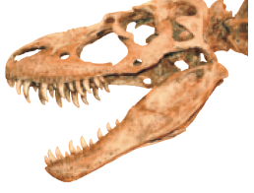
A scientist finds a dinosaur tooth about 3 cm long. What is a more precise measurement for the tooth? Use decimal parts of a centimeter to find out.

Slide 5
Write the length of the segment as a decimal number of centimeters.

Slide 6
Metric units of length
millimeter (mm) | centimeter | meter
1 mm = 0.1 cm | 1 cm = 10 mm | 1 m = 1000 mm
1 mm = 0.001 m | 1 cm = 0.01 m | 1 m = 100 cm
 |  | 1 m = 0.0001 km

Slide 7
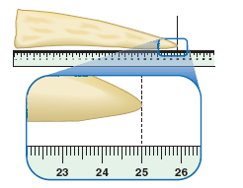
Find the length of the triceratops horn to the nearest hundredth of a meter.

Slide 8
p. 127 #1-4, 24-28 and 36 Go to classzone eWorkbook 3.2 if you finish early.

