Slide 1
Lesson 2.4 and 2.5
Goal: The learner will create and interpret frequency tables and bar graphs.

Slide 2
Frequency Table
A table that lists the number of times each item occurs in a data set. Helps display data in distinct categories.
Painting | Sculpture
Painting | Painting
Painting | Drawing
Sculpture | Sculpture
Drawing | Sculpture
Painting | painting
Art Project | Tally | Frequency
Painting
Sculpture
Drawing

Slide 3
Make a frequency table of the data.
6,5,4,4,5,3,9,8,6,4,3,4,7,5,4,3,8,4,9,3
Number | Tally | Frequency
3
4
5
6
7
8
9

Slide 4
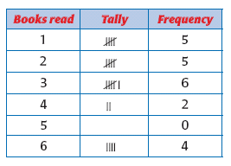
Line Plot
Use x to mark above a number line to show the frequencies.
Make a line plot of the data.
Use the line plot to find the total number of students.
Use the line plot to find how many students read four or more books.
1 2 3 4 5 6 7 8 9

Slide 5
Bar Graph
A graph that uses bar lengths to represent and compare data.
Things to Remember:
Start the scale a zero and where the scale should end.
Use equal amounts for the increments
Label your graph; title and the scale

Slide 6
Make a bar graph.
Types of Books in a Home Library
Type of book
children’s
young adult
adult fiction
reference
Number of books
32
12
38
22

Slide 7
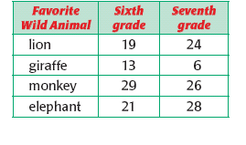
Double Bar Graph
Since there is more than one bar for each category, you will need a key.

Slide 8
Make a double bar graph.
Favorite Sports
Sport
basketball
swimming
gymnastics
hockey
track
Watching
593
260
370
175
250
Participating
570
319
197
197
209

Slide 9
Assignment
P. 78 #3,4,7,18-21
P.85 #3, 7, 9, 12

