Slide 1
Lesson 13.8
Goal: The learner will represent data using box-and-whisker plots.

Slide 2
Vocabulary
Box-and-whisker plot: divides data set into four parts, two below the median and two above.
Lower quartile: the median of the lower half of the data
Upper quartile: the median of the upper half
Lower extreme: smallest data value
Upper extreme: greatest data value

Slide 3
Steps
Order data to find the median
Find the median, find the lower half and upper half
Find the lower quartile and upper quartile
Draw a number line and plot the values BELOW the number line.
Draw a box with sides at both quartiles
Draw a vertical line through the median
Draw “whiskers” from the box to both extremes

Slide 4
Example
14, 36, 8, 12, 24, 27, 22, 42, 25, 19, 18
Order it:

Slide 5
Create a box-and-whisker plot
Make a box-and-whisker plot of the data: 5, 9, 16, 8, 6, 15, 14, 5, 15, 12.

Slide 6
Why do we create box-and-whisker plots?
They show how data is distributed.
You can easily find the median and extremes
Divides data into fourths
Identify the median, the lower and upper quartiles, and the lower and upper extremes in the box-and-whisker plot below.

Slide 7
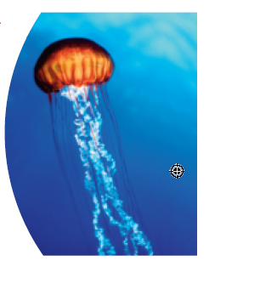
The box-and-whisker plots below represent the body widths (in inches) of a sample of jellyfish from two different species.
Find the range of the body widths.
Compare the body widths in the two samples.

Slide 8
Assignment
P.716 #2,3,4,7-11, 17-19

