Slide 1
Lesson 13.2
Goal: The learner will use diagrams, tables, and lists to find outcomes.

Slide 2
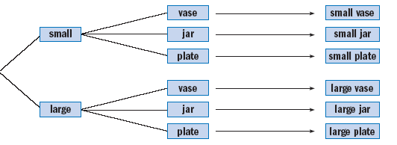
Tree Diagram
An organized way to list all possible outcomes.
You can choose a small or large size. And you can paint a vase, jar, or plate. What are the different kinds of pottery you can paint?

Slide 3
Let’s do this.
You can order a turkey, ham or roast beef sandwich. You can choose rye, white or oatmeal bread. List all the possible sandwiches.

Slide 4
You do it.
A roller hockey team is choosing jerseys. The body can be red, white, purple, green, or blue. The sleeves can be clack, red, or blue. List all the possible jerseys that the team can choose.

Slide 5
Combinations and Permutations
Combination is grouping objects.
How many combinations of two letters can you make with the letters A, B, and C?
Permutation is ordering objects.
How many permutations, different orders, of two letters can you make with the letters A, B, and C?

Slide 6
Combination
You can choose 2 toppings for a sundae from nuts, sprinkles, caramel, and marshmallows. Find the possible pairs of toppings.
Nuts | Sprinkles | Caramel | Marshmallows | Outcomes
Why is this a combination? Why doesn’t order matter?

Slide 7
Permutation
List all two digit numbers that can be formed using two different digits from 1, 4, 7, and 9.
Why is this a permutation? Why does order matter?

Slide 8
Permutation or Combination?
Decide if it is a permutation or combination.
Running a race a having 1st, 2nd and 3rd place.
Making a team for basketball.
You can choose two vegetables for a stir-fry and list all the possible pairs of vegetables.
You are placing a math book, a novel, and a dictionary on the shelf and list all the possible orders for the books.

Slide 9
Assignment
P.693 #1-7, 11-12, 18, 19

