Slide 1
Lesson 12.7
Goal: The learner will use properties of similar solids.

Slide 2
Similar or Not
Similar solids have equal ratios of corresponding linear measures, like heights or radii.

Slide 3
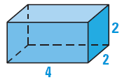
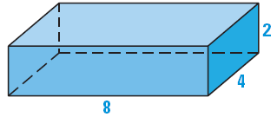
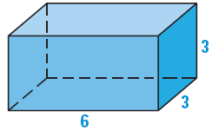
Are they similar?
Tell whether the given right rectangular prism is similar to the right rectangular prism shown at the right.
a.
b.

Slide 4
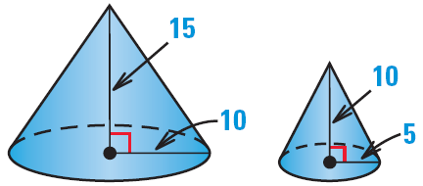
Are they similar?

Slide 5
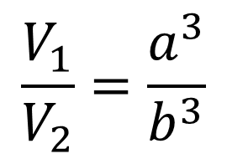
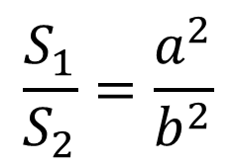
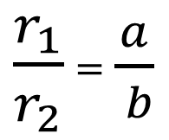
Similar Solids Theorem
$\frac{r_{1}}{r_{2}}$ = $\frac{a}{ b}$
$$\frac{S_{1}}{S_{2}}=\frac{a^{2}}{b^{2}}$$
$$r_{1}$$
$$r_{2}$$
$$\frac{V_{1}}{V_{2}}=\frac{a^{3}}{b^{3}}$$

Slide 6
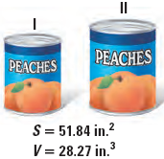
The cans shown are similar with a scale factor of 87:100. Find the surface area and volume of the larger can.

Slide 7
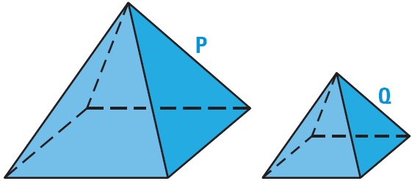
Work It Backwards.
The pyramids are similar. Pyramid P has a volume of 1000 cubic inches and Pyramid Q has a volume of 216 cubic inches. Find the scale factor of Pyramid P to Pyramid Q.

Slide 8
Assignment
p.850 #3-6, 8,9,11-14,

