Slide 1
Lesson 12.6
Goal: The learner will find surface area and volumes of spheres.

Slide 2
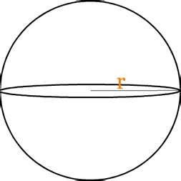
Sphere: set of all points equidistant from a given point.
$$Surface Area=4πr^{2}$$
r= 8 in. Find the surface area.

Slide 3
Example

Slide 4
Great Cirlces
A plane that cuts through the center of the sphere.
Half of sphere is a
Hemisphere.

Slide 5
Volume of a Sphere
$$Volume= \frac{4}{3}πr^{3}$$
The soccer ball has a diameter of 9 inches. Find its volume.

Slide 6
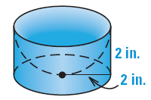
Find the volume.
Find the volume of the composite solid.

Slide 7
Assignment
P.842 # 3-5, 7-8, 12-14, 16, 21, 33

