Slide 1
Lesson 12.4
Goal: The learner will solve multiplication and division equations.

Slide 2
How to Solve
Always do the opposite.
Remember the Golden Rule of Algebra.
Isolate the variable.
What’s the opposite of multiply?
What’s the opposite of divide?

Slide 3
Examples
5x=20
4n = 24
24 = 2p

Slide 4
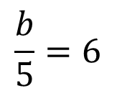
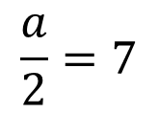
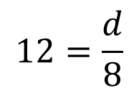
Examples
$$\frac{a}{2}=7$$
$$\frac{b}{5}=6$$
$$12=\frac{d}{8}$$

Slide 5
Use an Equation
In a local cheerleading competition, a team is awarded points in 3 categories. The mean of the team’s scores for the 3 categories is 19.2. Write and solve a division equation to find t, the total number of points the team earns.

Slide 6
Combining like terms
If they have the same variable, you and add/subtract them.
5x + 2x =35
21x – 7x =28

Slide 7
Assignment
P. 648 #3,4, 8-22e, 24, 29-31, 39, 40, 45, 46

