Slide 1
Lesson 11.7
Goal: The learner will use lengths and areas to find geometric probability.

Slide 2
Probability
Geometric Probability = $\frac{Part}{Whole}$
Find the probability that a point chosen at random on PQ is on RS .

Slide 3
Example
A monorail runs every 12 minutes. The ride from the station near your home to the station near your work takes 9 minutes. One morning, you arrive at the station near your home at 8:46. You want to get to the station near your work by 8:58. What is the probability you will get there by 8:58?
Step 1: What’s the longest you can wait?
Step 2: Model
Step 3: Find the probability.

Slide 4
Probability and Area
Probability = $\frac{area part}{area whole}$
What’s the probability of being in the square?
4 m
10 m
4 m
12 m

Slide 5
The diameter of the target shown at the right is 80 centimeters. The diameter of the red circle on the target is 16 centimeters. An arrow is shot and hits the target. If the arrow is equally likely to land on any point on the target, what is the probability that it lands in the red circle?

Slide 6
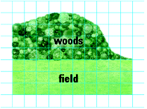
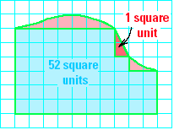
Your dog dropped a ball in a park. A scale drawing of the park is shown. If the ball is equally likely to be anywhere in the park, estimate the probability that it is in the field.

Slide 7
Assignment
P.774 #3-6, 9-10,12-14,23,30

