Slide 1
Lesson 11.5
Goal: The learner will divide integers.

Slide 2
Rules
Divide two positives = positive
Divide two negatives = positive
Divide a negative and positive = negative
Odd amount of negatives = negative
You can divide by zero

Slide 3

Examples
$18÷\left(−2\right)$
$−27÷\left(−9\right)$
$0÷(−5)$
$−6÷0$

Slide 4
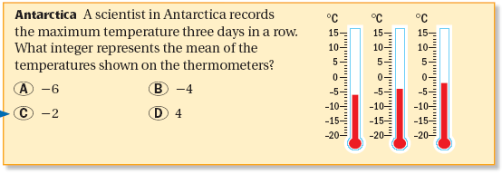

Slide 5
Assignment
P.599 #9-18, 24, 31, 33, 39, 56

