Slide 1
Lesson 11.2
Goal: The learner will add integers.

Slide 2
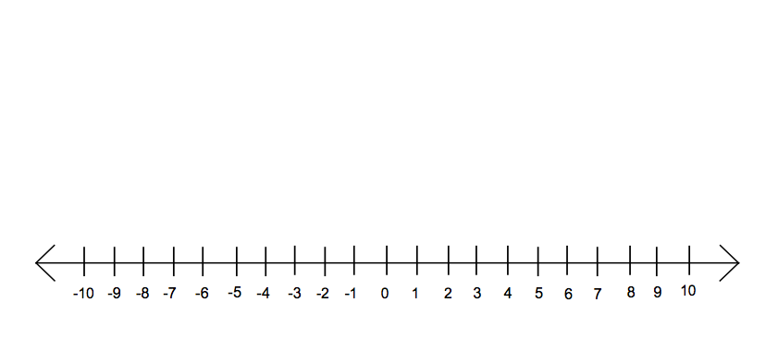
Example
During a high school football game, your team gained 6 yards on the first play, lost 8 yards on the second play, and gained 11 yards on the third play. Did your team gain the 10 yards needed for a first down?

Slide 3
Some more work on a number line.
Find the sum using the number line.
1. -4 + (-4) 2. -6 + 6 3. -8 + 1- 4. 5 + (-9)

Slide 4
What happened when…
We added two negatives?
When we added a negative and a positive?
What happened when we added a number and its negative?

Slide 5
Adding integers can be addition or subtracion.
Same signs: add and keep the sign
Different signs: subtract the numbers and keep the sign of the number farthest from zero
Opposites: the sum of opposites is zero

Slide 6
Find the sum.
-4 + (-7)
-8 + 3
-6 + 9

Slide 7
Your Turn!
8 + (-15)
-10 + (-5)
25 + (-25)

Slide 8
Absolute Value
Distance from zero and the number line.
$Absolute value: \left|−3\right|=\left|3\right|$=3

Slide 9
Assignment
P. 581 #16-28 evens, 40-42, 51

