Slide 1
Lesson 11.1
Goal: The learner will compare and order integers.

Slide 2
Integers
No fractions or decimals!
Negative integers: less than 0
Positive integers: greater than 0
Negative numbers
Positive numbers
-4 -3 -2 -1 0 1 2 3 4

Slide 3
Integer words
Positive Words
Negative words
Profit
Increase
above
Loss
Decrease
below

Slide 4
Rewrite as an integer
A $15 profit
A 9 point decrease
A loss of 5 yards

Slide 5
Opposites
Two numbers are opposites if they are the same distance from 0 but opposite sides of 0.
Example:
What’s the opposite of -4?
What’s the opposite of 7?

Slide 6
Compare integers
Compare -8 and -5

Slide 7
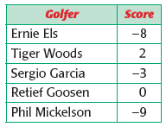
Ordering integers

Slide 8
Assignment
p. 574 #3-5, 9-11, 14, 19,20,23-25, 32, 35-37

