Slide 1
Lesson 10.7
Goal: The learner will write the equations of circles in the coordinate plane.

Slide 2
Equation of a Circle.
$${(x−h)}^{2}+{(y−k)}^{2}=r^{2}$$
The center of the circle
Any point on the circle; stays variables
radius

Slide 3
Examples
Find the equation of a circle with a center (0, -9) and a radius of 5.

Slide 4
Example
Find the equation of a circle with a center (2, -3) and a radius of 12.

Slide 5

Example
Find the equation of a circle with a center (0, 0) and a radius of $\sqrt{10}$.

Slide 6
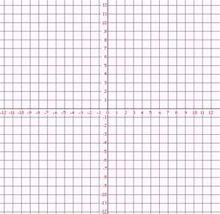
Find the equation of a circle.

Slide 7
Find the equation of the circle.

Slide 8

Graph the circle.
${(x−4)}^{2}+{(y+2)}^{2}=36$

Slide 9

Graph the circle.
${(x+2)}^{2}+{(y−3)}^{2}=16$

Slide 10
Assignment
P.702 #3-15, 20-22

