Slide 1
Goal: The learner will find segment lengths in circles.
Lesson 10.6

Slide 2
Segments of Chords
Part*Part=Part*Part
$EA∙EB=EC∙ED$
A
C
E
D
B

Slide 3
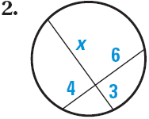
Try it out.
Find x.

Slide 4
Another Example
Find x.
x
6
3
8

Slide 5
Secant Segments
Outside * Whole = Outside * Whole
$EA∙EB=EC∙ED$
B
A
E
C
D

Slide 6
Try it.

Slide 7
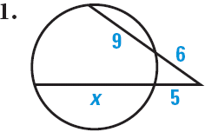
Some more examples

Slide 8

Secants and Tangents
$Outside∙Whole={Outside}^{2}$
${EA}^{2}=EC∙ED$
A
E
C
D

Slide 9
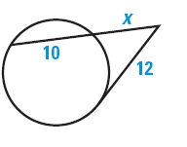
Example
Find x.

Slide 10
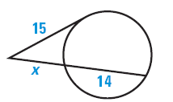
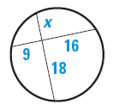
How would you set it up?

Slide 11
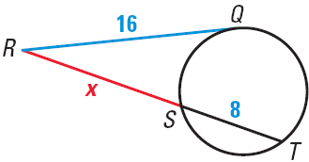
Try it out.
Find x.

Slide 12
Tethys, Calypso, and Telesto are three of Saturn’s moons. Each has a nearly circular orbit 295,000 kilometers in radius. The Cassini-Huygens spacecraft entered Saturn’s orbit in July 2004. Telesto is on a point of tangency. Find the distance DB from Cassini to Tethys.

Slide 13
Assignment
P.692 #3,4, 6,7 9,10, 12-14
Challenge #18

