Slide 1
Lesson 10.5
Goal: The learner will find the measure of angles inside or outside the circle.

Slide 2
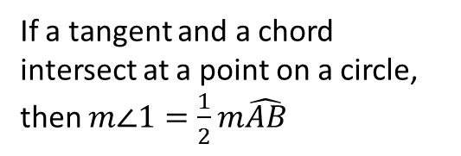
Tangents and Chords
If a tangent and a chord intersect at a point on a circle, then $m∠1=\frac{1}{2}m\hat{AB}$
B
1
A

Slide 3
Examples

Slide 4
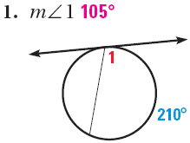
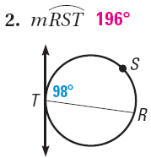
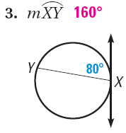
Some More Examples

Slide 5
Possibilities are Limited
Intersect on the circle
Intersect in the circle
Intersect outside the circle

Slide 6
Inside the circle
The angle measure is half the sum of the intercepted arcs.
$$m∠1=\frac{1}{2}(m\hat{DC}+m\hat{AB)}$$
A
D
$$m∠2=\frac{1}{2}(m\hat{AD}+m\hat{BC})$$
1
2
B
C

Slide 7
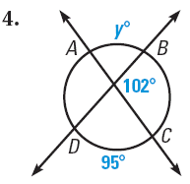
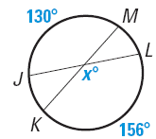
Example

Slide 8
Outside the circle
The angle measure is half the difference of the intercepted arcs.
$$m∠1=\frac{1}{2}(m\hat{AD}−m\hat{BC})$$
B
1
A
C
D

Slide 9
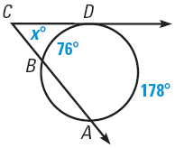
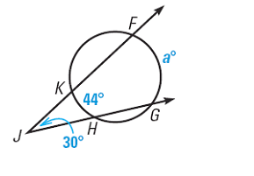
Example

Slide 10
Assignment p.683 #3-14, 22, 23

