Slide 1
Lesson 10.4
Goal: The learner will used inscribed angles of circles.

Slide 2
Vocabulary
Inscribed Angle: angle with vertex on the circle.
Intercepted Arc: the arc formed with the endpoints of an inscribed angle.
Intercepted arc
Inscribed angle

Slide 3
Measuring Angles
The measure of the inscribed angle is half the measure of its intercepted arc.
60˚
120˚

Slide 4
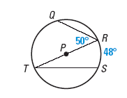
Find that angle or arc
Find the indicated measure in P.
$$m∠T$$
$$m\hat{QR}$$

Slide 5
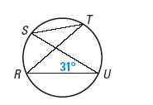
How about another?
Find mRS and m STR. What do you notice about STR and RUS?

Slide 6
Intercepting the same arc
If two inscribed angles of a circle intercept the same arc, then the angles are congruent.
A
$$∠ADB≅∠ACB$$
B
D
C

Slide 7
Example

Slide 8
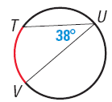
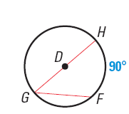
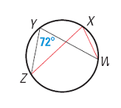
Find the red arc or angle.

Slide 9
Inscribed Polygons and Circles
Inscribed Polygon: a polygon with all its vertices on the circle.
Circumscribed Circle: the circle that contains the vertices.

Slide 10
If a right triangle is inscribed in a circle, then the hypotenuse is a diameter of the circle.
Diameter and hypotenuse

Slide 11
Inscribed Quadrilaterals
A quadrilateral can be inscribed in a circle if and only if opposite angles are supplementary.
F
E
$$m∠D+m∠F=m∠E+m∠G=180˚$$
D
G

Slide 12
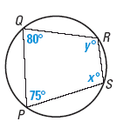
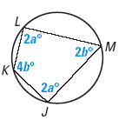
Find the value of each variable.
a.
b.

Slide 13
Assignment
P. 676 #3-15, 17

