Slide 1
Lesson 10.3
Goal: The learner will use relationships of arcs and chords in a circle.

Slide 2
Congruent Chords
In the same circle or congruent circles:
$$\hat{AB}≅\hat{CD} if and only if \overline{AB}≅\overline{CD}$$
A
C
B
D

Slide 3
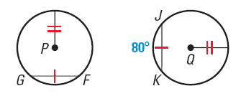
Example
In the diagram, P Q, FG JK , and mJK = 80º. Find mFG

Slide 4
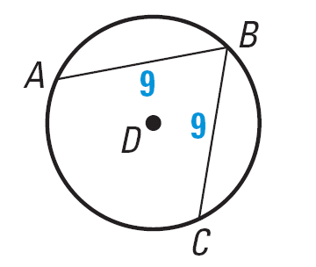
Another Example
Use the diagram of D.
1. If mAB = 110°, find mBC
2. If mAC = 150°, find mAB

Slide 5
Chords and Diameters
If a chord is perpendicular to another chord, then it’s a diameter.
If a diameter is perpendicular to a chord, the it bisects the chord and its arc.
F
$$\overline{HD}≅\overline{HF}and \hat{FG}≅\hat{GD}$$
G
H
D

Slide 6
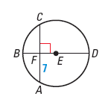
Example
Use the diagram of E to find the length of AC .

Slide 7
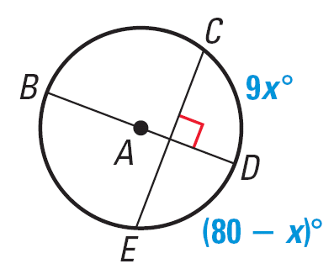
Another
Find the measure of the indicated arc in the diagram.
$$\hat{CD}$$
$$\hat{DE}$$
$$\hat{CE}$$

Slide 8
Last One
In the same circle or congruent circles, two chords are congruent if and only if they are equidistant from the center.

Slide 9
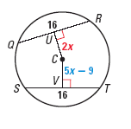
Example
In the diagram of C, QR = ST = 16. Find CU.

Slide 10
Assignment
P.667 #3-14, 18-20

