Slide 1
Lesson 10.2
Goal: The learner to use angle measures to find arc measures.

Slide 2
Vocabulary
Central Angle: Angle whose vertex is the center of the circle.
Minor Arc: $m∠ABC$ is less than 180˚
Major Arc: $m∠ABC$ is more than 180˚
Semicircle: half the circle.
A
B
C
D

Slide 3
Measuring Arcs
The measure of the arc is equal to the central angle that intersects the arc.
A
$$m\hat{AB=}$$
50$˚$
B

Slide 4
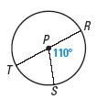
Find the measures
Find the measure of each arc of P, where RT is a diameter.
a.
RS
b.
RTS
c.
RST

Slide 5
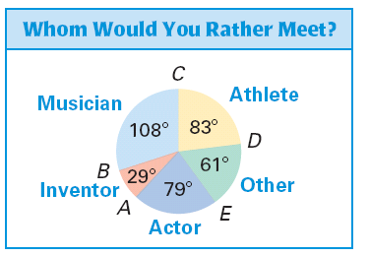
Finding the measure of arcs
A recent survey asked teenagers if they would rather meet a famous musician, athlete, actor, inventor, or other person. The results are shown in the circle graph. Find the indicated arc measures.
a.
mAC
b.
mACD
c.
mADC
d.
mEBD

Slide 6
Congruent Circles and Arcs
Congruent circles: two circles with the same radius.
Congruent arcs: two arcs are congruent if they have the same measure and they arcs of the same circle or congruent circles.

Slide 7
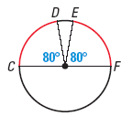
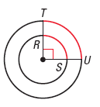
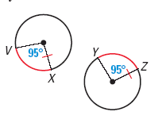
Identify Congruent Arcs
a.
b.
c.

Slide 8
Assignment
P.661 #3-10,12-14, 22

