Slide 1
Lesson 10.1
Goal: The learner will use properties of a tangent to a circle.

Slide 2
Vocabulary
Circle: all points equidistant from a give point called the center.
Name the circle as $⨀$P
Radius: segment from center to point on the circle
Chord: segment whose endpoints are on a circle.
Diameter: a chord that contains the center of the circle.
radius
P
diameter
chord

Slide 3
More Vocabulary
Secant: a line that intersects a circle twice
Tangent: a line that intersects a circle once.
Point of tangency: where the tangent intersects the circle.
secant
tangent

Slide 4
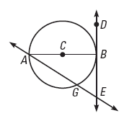
Tell whether the line, ray, or segment is best described as a radius, chord, diameter, secant, or tangent of C.
$\overline{AC}$
$\overline{AB}$
$\vec{DE}$
$\overset{⃡}{AE}$

Slide 5
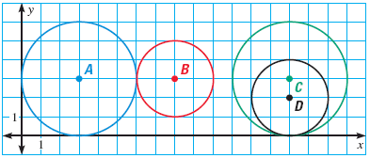
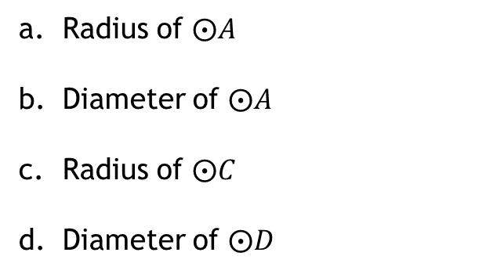
Use the diagram to find the given lengths.
Use the diagram to find the given lengths.
a. Radius of $⨀A$
Diameter of $⨀A$
Radius of $⨀C$
Diameter of $⨀D$

Slide 6
Coplanar Circles
Two circles can intersect in two points, one point or not at all.

Slide 7
Common Tangent
Two coplanar circle tangent to the same ray, line or segment.

Slide 8
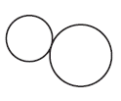
How many common tangents do the circles have?
a.
b.
c.

Slide 9
Tangents and Circles
If a line is tangent to a circle if and only if it’s perpendicular to the radius.

Slide 10
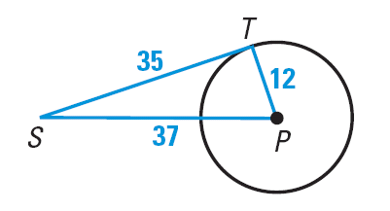
Example Time
In the diagram, $\overline{PT}$ is a radius of $⨀$P. Is $\overline{ST}$tangent to $⨀$P?

Slide 11
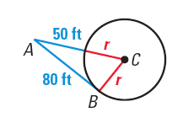
Another One
In the diagram, B is a point of tangency. Find the radius r of C.

Slide 12
Another Happy Theorem
Tangents segments from a common external point are congruent.
10
10

Slide 13
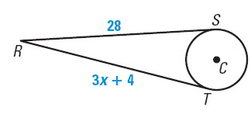
Just another example
RS is tangent to C at S and RT is tangent to C at T. Find the value of x.

Slide 14
Assignment
P. 655 #3-10,18-24

