Slide 1
Chapter 6 Descriptive Statistics
6A: TLW identify types of data.

Slide 2
Vocabulary
Population: defined collection about which we want to draw a conclusion
Census: collect information from whole population
Sample: collect information from random subset of population
Survey: collection of information from a sample
Data: information collected
Parameter: numerical quantity measuring some aspect of a population
Statistic: quantity calculated from data collected

Slide 3
Types of Data
Categorical Variable: DESCRIBES a particular characteristics
Categories: how data is divided
Example: Computer operating systems
Windows, Mac, Linux
Quantitative Variable: has a numerical value
Discrete: counting
Quantitative discrete variable
Number of apricots on a tree
Number of players in a tournament
Continuous: measuring
Quantitative continuous variable
Times taken to run a 100 m race
Heights of students in class

Slide 4
Example Time
Classify these variables as categorical, quantitative discrete, quantitative continuous.
The number of heads when 3 coins are tossed
The brand of toothpaste used by the students in class
The heights of a group of 15 year old children

Slide 5
Try These
P. 160 #1, 2

Slide 6
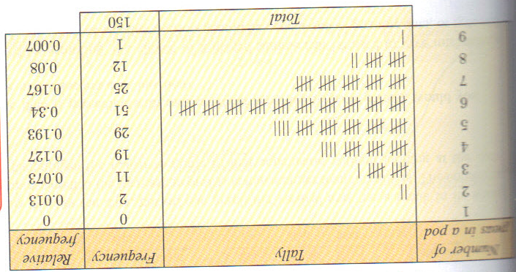
6B Goal: TLW organize and display discrete data.
Frequency Table: shows how many times value occurs in data set
Relative Frequency: frequency as a % of data

Slide 7
Column Graph (Bar Graph)
Quantitative discrete data
Range of data = horizontal axis
Frequency of data = vertical axis
Column widths are equal and height represents frequency
Gaps between columns– data is discrete
What’s the mode of this data?
frequency

Slide 8
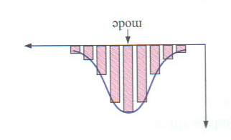
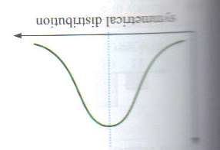
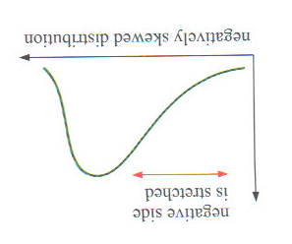
Describing the Distribution of a Data Set
Symmetry/Partial Symmetry: symmetry about the mode
Symmetrical distribution: curve of columns show symmetry
Negatively Skewed: curve “stretched” to the left
Positively Skewed: curve “stretched” to the right

Slide 9
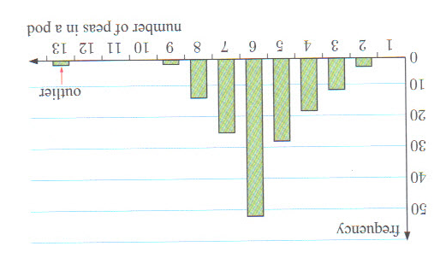
Outliers
Data values either or much smaller than general body of data

Slide 10
Example
30 children attended a library holiday program. Their year levels at school were:
8 7 6 7 7 7 9 7 7 11 8 10 8 8 9
10 7 7 8 8 8 8 7 6 6 6 6 9 6 9
Record the information in a frequency table , including relative frequency.
Construct a column graph.
What is the modal year level?
Describe the shape of the distribution. Are there outliers?
What percentage of children were in year 8 or below?
What percentage of the children were above year 9?

Slide 11
Assignment
P. 164 #1-5

Slide 12
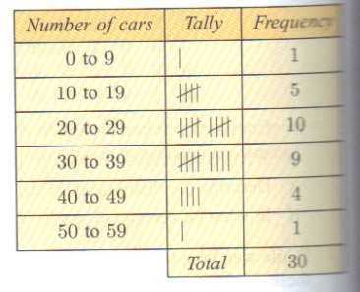
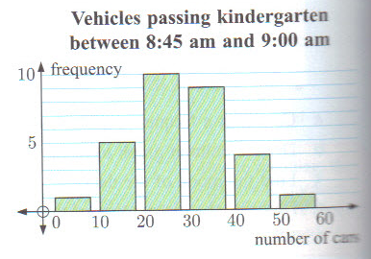
6C TLW interpret quantitative discrete data.
Use when there are different data values with very frequencies.
Makes it hard to study data distribution
Group into class intervals and compare the frequency for each class
Modal Class– class with highest frequency.
Column Graph: for grouped discrete data in the same was as before
If we are given a set of raw data, how can we efficiently find the lowest and highest data values?
If the data values are grouped in classes on a frequency table/column graph, do we still know what the highest and lowest values are?

Slide 13
p. 166 #1
Arthur catches the train to school from a busy train station. Over the course of 30 days he counts the number of people waiting at the station when the train arrives.
17 25 32 19 45 30 22 15 28 8
21 29 37 25 42 35 19 31 26 7
22 11 27 44 24 22 32 18 40 29
Construct a tally and frequency table for this data using class intervals 0-9, 10-19, …, 40-49.
On how many days were there less than 10 people at the station?
On what percentage of days were there at least 30 people at the station?
Draw a column graph to display the data.
Find the modal class of the data.

Slide 14
Your Turn
p. 166 #2-3

Slide 15
6D: TLW identify and apply quantitative continuous data.
Continuous: cannot write down exact values
Heights of students
Time it takes to run a race
Class intervals: group data because no two data values will be exactly the same.
Frequency Histograms: displays grouped continuous data
Like a bar graph but columns joined!
Edges of columns show the boundaries of class intervals
discrete
continuous

Slide 16
Other Stuff
Modal Class: values that appear most often
Tallest bar in frequency histogram
Rule of Thumb: use approximately $\sqrt{number of individuals}$ the number of classes for a data set.
Large sets of data use more classes not less

Slide 17
Example
A sample of 20 juvenile lobsters was randomly selected from a tank containing several hundred. The length of each lobster was measured in cm, and the results were:
4.9 5.6 7.2 6.7 3.1 4.6 6.0 5.0 3.7 7.3
6.0 5.4 4.2 6.6 4.7 5.8 4.4 3.6 4.2 5.4
Organize the data using a frequency table, and hence graph the data.
Length (l cm) | Tally | Frequency

Slide 18
Assignment
P. 168 #1-6

Slide 19
6E TLW find measures of central tendency and interpret them.
Knowing the middle of the data helps to understand it
What’s the spread of the data?
Mode: most frequent value
Bimodal: has two modes; ignore if there are more than 2 modes
Mean = $\frac{sum of all data values}{number of data values}$
a single number which indicates a center of the data
Not necessarily a member of the set
Population ($μ$)= mean of the entire population
Not always possible
Sample mean ($\overline{x}$) = approximation of $μ$

Slide 20
Formula for Mean
n = # data values in the sample
$x_{i}=i^{th}$ data from $\left\{x_{1},x_{2},x_{3},…,x_{n}\right\}$
$\overline{x}=\frac{x_{1}+x_{2}+…+x_{n}}{n}=\frac{\sum_{i=1}^{n}{x_{1}}}{n}$
Note: $\sum_{i=1}^{n}{x_{i}}$means sum all n data values: $x_{1}+x_{2}+x_{3}+…+x_{n}$

Slide 21
Median
Middle value of an ordered data set
Order data from smallest to largest
Split the data in halves
Odd number data– median one of the original in data set
Even number data– average of 2 middle numbers
Rule: if there are n data values, find $\frac{n+1}{2}$. The median is that data value

Slide 22
Example
Find the mean, mode and median:
3, 6, 5, 6, 4, 5, 5, 6, 7
13, 12, 15, 13, 18, 14, 16, 15, 15, 17

Slide 23
Using Your GDC
A teenager recorded the time (in minutes per day) he spent playing computer games over a 2 week holiday period:
121, 65, 45, 130, 150, 83, 148, 127, 20, 173, 56, 49, 104, 97
Using technology, determine the mean and median daily game time the teenager recorded.

Slide 24
Assignment
P. 172 # 1, 2, 4, 6, 8-17
Use your GDC to help!!!

Slide 25
Effects of Outliers
Outliers: extreme values, much greater than or much less than the other values.
Consider the set of data: 4, 5, 6, 6, 6, 7, 7, 8, 9, 10.
Calculate: a. mean b. mode c. median
We now introduce the extreme value of 100 to the data, so that the data set is now: 4, 5, 6, 6, 6, 7, 7, 8, 9, 10, 100
Calculate: a. mean b. mode c. median
Comment on the effect that the extreme value has on:
Which of the three measures of central tendency is most affected by the inclusion of an outlier.
When is it not appropriate to use a particular measure of the center of a data set?

Slide 26
Choosing the Appropriate Measure
Mode: gives the most usual value
Only takes common values into account
Not affected by extreme values
Mean: commonly used & easy to understand
Takes all value into account
Affected by extreme values
Median: gives halfway point
Only takes middle values into account
Not affected by extreme values

Slide 27
Examples
A shoe store is investigating the sizes of shoes sold over one month. The mean shoe size is not very useful to know, but the mode shows at a glance which size the store most commonly has to restock.
On a particular day a computer shop makes sales of $900, $1250, $1000, $1700, $1140, $1100, mean is $1200. The mean is the best measure of center as the salesman can use it to predict average profit.
When looking at real estate prices, the mean is distorted by the few sales of very expensive houses. For a typical house buyer, the median will best indicate the price they should expect to pay in a particular area.

Slide 28
Measure of the Center From Other Sources
Find the mode, mean and median from the table.
Data value (x) | Frequency (f) | Product (fx)
3 | 1 | 1*3=3
4 | 1 | 1*4=4
5 | 3 | 3*5=15
6 | 7 | 7*6=42
7 | 15 | 15*7=105
8 | 8 | 8*8=64
9 | 5 | 5*9=45
Total | $$\sum{f}=40$$ | $$\sum{fx}=278$$

Slide 29
Example
The table shows the number of aces served by tennis players in their first sets of a tournament.
Determine the: mean, median, mode for this data.
Number of aces (x) | Frequency (f) | Product (fx) | Cummulative Frequency
1 | 4
2 | 11
3 | 18
4 | 13
5 | 7
6 | 2

Slide 30
Example with the GDC
Find the mean and median with the GDC.
Number of aces (x) | Frequency (f)
1 | 4
2 | 11
3 | 18
4 | 13
5 | 7
6 | 2

Slide 31
Assignment
P. 178 #1-5

Slide 32
Data in Classes
Information is grouped in classes
Use the midpoint or mid-interval value to represent values in the interval
Assumption: values are evenly distributed throughout interval
Mean is an approximation of the true value

Slide 33
Mid-Interval Values
What effect will using mid-interval values representing all scores in an interval have on estimating the mean of the grouped data.
Calculate the mean using the highest possible results.
Calculate the mean of the results using the lowest possible results.
Calculate the mean using the mid-interval values.
How do they compare?
Marks | Frequency
0-9 | 2
10-19 | 31
20-29 | 73
30-39 | 85
40-49 | 28

Slide 34
Example
Estimate the mean of the following ages of bus drivers data, to the nearest year.
Age | Frequency | Midpoint | fx
21-25 | 11
26-30 | 14
31-35 | 32
36-40 | 27
41-45 | 29
46-50 | 17
51-55 | 7

Slide 35
Assignment
P. 181 #1-6

Slide 36
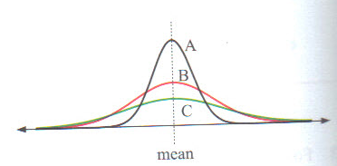
6F: TLW measure the spread of data.
To accurately describe distribution, you need to know the center and how the data spreads out.
The A distribution has most scores around the mean
The C distribution has the greatest spread.

Slide 37
Measurements
Range: largest – smallest
Not particularly reliable measurement of spread; only uses two data points
A library surveys 20 borrowers each day from Monday to Friday, and records the number who are not satisfied with the range of reading material. The results are: 3 7 6 8 11.
The following year the library receives a grant that enables the purchase of a large number of books. The survey is then repeated and the results are: 2 3 5 4 6.
Find the range of data in each survey.

Slide 38
Quartiles and the Interquartile Range (IQR)
Median divides the data into halves
Divides data into halves again = quartile
Lower quartile= 25 % percentile ($Q_{1})$
25% of data have values less than or equal to lower quartile
75% of data greater than value
Upper quartile = 75% percentile ($Q_{3})$
25% of data have values greater or equal to upper quartile
IQR= Upper Quartile – Lower Quartile = $Q_{3}−Q_{1}$

Slide 39
Example
For the data set: 7, 3, 1, 7, 6, 9, 3, 8, 5, 8, 6, 3, 7, 1, 9
Find the median
Find the lower quartile
Find the upper quartile
Find the IQR

Slide 40
Example
For the data set: 6, 4, 9, 15, 5, 13, 7, 12, 8, 10, 4, 1, 13, 1, 6, 4, 5, 2, 8, 2
Find the median
Find the $Q_{1}$
Find the $Q_{2}$
Find the IQR

Slide 41
Data and the GDC
Consider the data set:
20, 31, 4, 17, 26, 9, 29, 37, 13, 42, 20, 18, 25, 7, 14, 3, 23, 16, 29
Find the Range and IQR with your GDC.

Slide 42
Assignment
P. 184 #1-2 without the GDC
P. 185 #3-4 with the GDC

Slide 43
6G: TLW create a box-and-whisker plot and interpret it.
Five-Number Summary
Minimum
Lower quartile
Median
Upper quartile
Maximum
**All are shown on a Box and Whisker

Slide 44
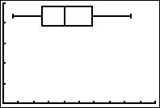
Box and Whisker
Box = middle half of data
Lower whisker = 25% of data with smallest values
Upper whisker = 25% of data with greatest values.

Slide 45
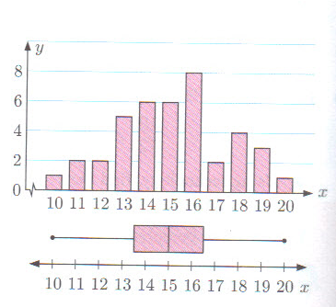
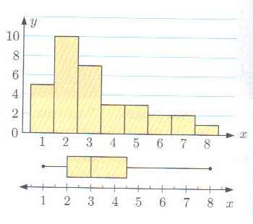
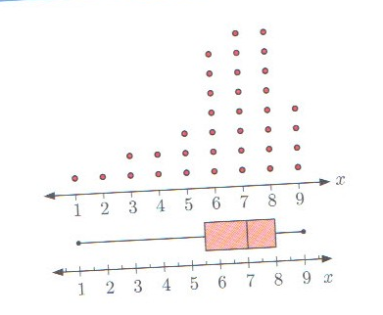
Interpreting a Boxplot
Symmetric distribution Positively skewed Negatively skewed
Whiskers of boxplot Right whisker is longer Left whisker is longer
Are the same length than left whisker than the right whisker
And the median line is and the median line is and the median line is
In the center of box to the left of the box is to the right of the box

Slide 46
Example
Consider the data set: 8, 2, 3, 9, 6, 5, 3, 2, 2, 6, 2, 5, 4, 5, 5, 6
Construct the five-number summary for this data.
Draw a boxplot
Find the range and IQR
Find the percentage of data values less than 3.

Slide 47
Assignment
P. 188 #1-5

Slide 48
Parallel Boxplots
Compares two data sets
Example: A hospital is trialling a new anesthetic drug and has collected data on how long the new and old drugs take before the patient becomes unconscious. They wish to know which drug acts faster and which is more reliable.
Old drug times: 8, 12, 9, 8, 16, 10, 14, 7, 5, 21
13, 10, 8, 10, 11, 8, 1, 9, 11, 14
New drug times: 8, 12, 7, 8, 12, 11, 9, 8, 10, 8,
10, 9, 12, 8, 8, 7, 10, 7, 9, 9
Prepare a parallel boxplot for the data sets and use it to compare the two drugs for speed and reliability.

Slide 49
Assignment
P. 190 #1-5 odds

Slide 50
Outliers
Extraordinary data separated from majority of data
Need to know upper and lower boundaries
Upper Boundary: $Q_{3}+1.5∗IQR$
Lower Boundary: $Q_{1}−1.5∗IQR$
Outliers are marked with an asterisk on a boxplot
Can have more than one on either end

Slide 51
Example
Test the following data for outliers and hence construct a boxplot for the data:
3, 7, 8, 8, 5, 9, 10, 12, 14, 7, 1, 3, 8, 16, 8, 6, 9, 10, 13, 7

Slide 52
Assignment
P. 192 #1 and 2

Slide 53
6H TLW create and interpret cumulative frequency graphs.
Information beyond the median
What proportion lie above or below a value
Cumulative frequency table
Cumulative frequency graph
Percentile: score below which a certain percentage of data lies.
85th percentile = score below which 85% of data falls below
If you score in 95th percentile = 95% of class scored less than you
$Q_{1}=25th percentile$
$Q_{2}=50th percentile$
$Q_{3}=75th percentile$

Slide 54
Example
Finishing time t | Frequency | Cumulative Frequency
2 h 26 ≤ t < 2 h 28 | 8
2 h 28 ≤ t < 2h 30 | 3
2 h 30 ≤ t < 2h 32 | 9
2 h 32 ≤ t < 2h 34 | 11
2 h 34 ≤ t < 2h 36 | 12
2 h 36 ≤ t < 2h 38 | 7
2 h 38 ≤ t < 2h 40 | 5
2 h 40 ≤ t < 2h 48 | 8
2 h 48 ≤ t < 2h 56 | 6
The data shows the result of the women’s marathon at the 2008 Olympics, for all competitors who finished the race.
Construct a cumulative frequency distribution table
Represent the data on a cumulative frequency graph
Use your graph to estimate the
Median finishing time
Number of competitors who finished in less than 2 hours 35 minutes
Percentage of competitors who took more than 2 hours 39 minutes to finish
Time taken by a competitor who finished in the top 20% of runners completing the marathon.

Slide 55
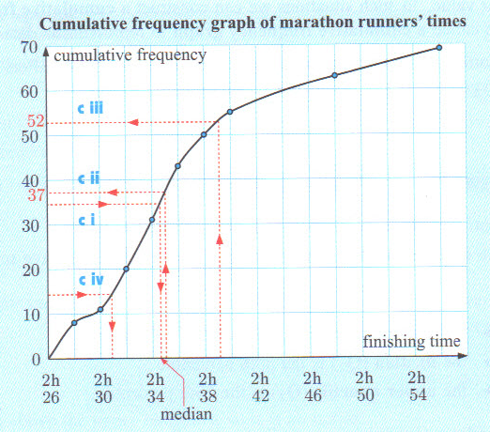
Finishing time t | Frequency | Cumulative Frequency
2 h 26 ≤ t < 2 h 28 | 8
2 h 28 ≤ t < 2h 30 | 3
2 h 30 ≤ t < 2h 32 | 9
2 h 32 ≤ t < 2h 34 | 11
2 h 34 ≤ t < 2h 36 | 12
2 h 36 ≤ t < 2h 38 | 7
2 h 38 ≤ t < 2h 40 | 5
2 h 40 ≤ t < 2h 48 | 8
2 h 48 ≤ t < 2h 56 | 6
Another way to calculate percentiles is to add a separate scale to a cumulative frequency graph. Putting corresponding right side of graph.

Slide 56
Assignment
P. 195 # 1-7odd

Slide 57
6I TLW find standard deviation and interpret.
Range and IQR measures of spread, but only uses two values in calculation
Some data has their spread hidden
Standard Deviation: takes the distribution of the data into account; how much does it deviate from the mean.
$$s_{n}=\sqrt{\frac{\sum_{i=1}^{n}{{\left(x_{i}−\overline{x}\right)}^{2}}}{n}}$$
${\left(x_{i}−\overline{x}\right)}^{2}$= how far $x_{i}$ deviates from $\overline{x}$
If $\sum_{i=1}^{n}{{\left(x_{i}−\overline{x}\right)}^{2}}$ is small, means data close to mean.
Dividing by n indicates on average data is from mean.
Square root corrects the units.

Slide 58
Standard Deviation
Non-resistant measure of spread
Only useful if distribution close to symmetrical
IQR/percentiles more appropriate if spread is considerably skewed.

Slide 59
Standard Deviation without GDC
Calculate the standard deviation of the data set: 2, 5, 4, 6, 7, 5, 6
Score (x) | $$x−\overline{x}$$ | $${\left(x−\overline{x}\right)}^{2}$$
2
4
5
5
6
6
7
35

Slide 60
Try it with GDC
Calculate the standard deviation of the data set: 2, 5, 4, 6, 7, 5, 6
Assignment: p. 199 #1-6

Slide 61
Standard Deviation for Grouped Data
Only for continuous data or data grouped in classes
Use mid-interval values to represent data for an interval

Slide 62
Example
Use technology to estimate the standard deviation for this distribution of examination scores:
Mark | Mid-interval | Frequency
0-9 |  | 1
10-19 |  | 1
20-29 |  | 2
30-39 |  | 4
40-49 |  | 11
50-59 |  | 16
60-69 |  | 24
70-79 |  | 13
80-89 |  | 6
90-99 |  | 2

Slide 63
Assignment
P. 201 #1-7

Slide 64
More 6I TLW compare the spread of two data sets.
Look at the mean of 2 data sets and compare
Also use their standard deviation to compare the spread
The following exam results were recorded by two classes of students studying Spanish. Use the GDC.
Class A: 64, 69, 74, 67, 78, 88, 76, 90, 89, 84, 83, 87, 78, 80, 95, 75, 55, 78, 81
Class B: 94, 90, 88, 81, 86, 96, 92, 93, 88, 72, 94, 61, 87, 90, 97, 95, 77, 77, 82, 90

Slide 65
Assignment
P. 203 #1-4

