Slide 1
Chapter 4
Equations and Formulae

Slide 2
Warm Up
If p = -2, q = 3 and r = 4, find
  p + 5q pr – 7q

Slide 3
Holly is studying overseas and makes a lot of calls back home. She is comparing two different mobile phone plans, both of which give free local calls, but which charge international calls at different rates. Plan A costs €25 for the monthly access fee and international calls are billed at 17 cents per minute. Plan B costs only €10 for the monthly access fee but international calls are billed at 23 cents per minute
Things to think about:
  Can you write a formula for each plan that connects total cost €C with the number of minutes m used on international calls per month?
  Use the formula to find the total cost for each plan if Holly’s international calls total
    150 minutes per month 300 minutes per month
  Find the values of m such that the cost of each plan is the same.
  What advice would you give Holly regarding her choice of plans?

Slide 4
Vocabulary to Know
Expression-variables and numbers but no =
  Simplify or Evaluate
Equation- variables and numbers but with =
  Solve
Formula- connects the values of variables

Slide 5
Linear Equation
Form ax + b = 0, highest exponent = 1
Solve: 8 – 4x = -2

Slide 6

Fractions! Say What?!
We get rid of fractions!
Multiply both sides by the LCD
$\frac{x}{4}+7=5$

Slide 7

Another One
$\frac{1}{3}\left(x+2\right)=6$
Try These: p. 95 #2

Slide 8
More than one variable
Solve: 4(2x + 5) -3(x – 2) = 16

Slide 9
Another
Solve: 4x – 3 = 3x + 7

Slide 10
And Another
Solve: 5 – 3(-1 + x) = x
CD begin p. 96 #1a – c, #3a, b
DP you will also do #4, but not yet.

Slide 11

Expand it and solve it.
${\left(x−3\right)}^{2}=\left(4+x\right)\left(2+x\right)$

Slide 12
DP
Do the others and include p. 97 #1

Slide 13
4C: TLW solve equations with fractions.

Slide 14

Get rid of fractions!
Solve: $\frac{2−x}{3}=\frac{x}{5}$

Slide 15

Again
Solve: $\frac{x+6}{−4}=\frac{x−1}{3}$
CD begin p. 99 #1

Slide 16

Warm Up!
Solve.
3(x-3) -4(x-5) = 2
$\frac{4x−9}{2}=8$

Slide 17

What’s different?
$\frac{3x+2}{1−2x}=\frac{1}{6}$

Slide 18

Another
Solve: $\frac{1}{x}=\frac{3}{x+8}$
DP: p. 99 #1-4

Slide 19
4D: TLW solve equations using the GDC.

Slide 20

Warm Up!
Solve
3(2x + 1) – 2(2x + 1) =10
$\frac{x+1}{x+3}=\frac{1}{2}$

Slide 21
Solve: 4.6x – 8.9 = 7.2
Equation must be set equal to zero first.
Press Math button and arrow down and select Solver.
Type in equation.
Place cursor on “x =“
Press Alpha then Enter

Slide 22
How can this be used?
It’s good to know when you DON’T have the skills to solve the equation.
Use it to check answers.

Slide 23
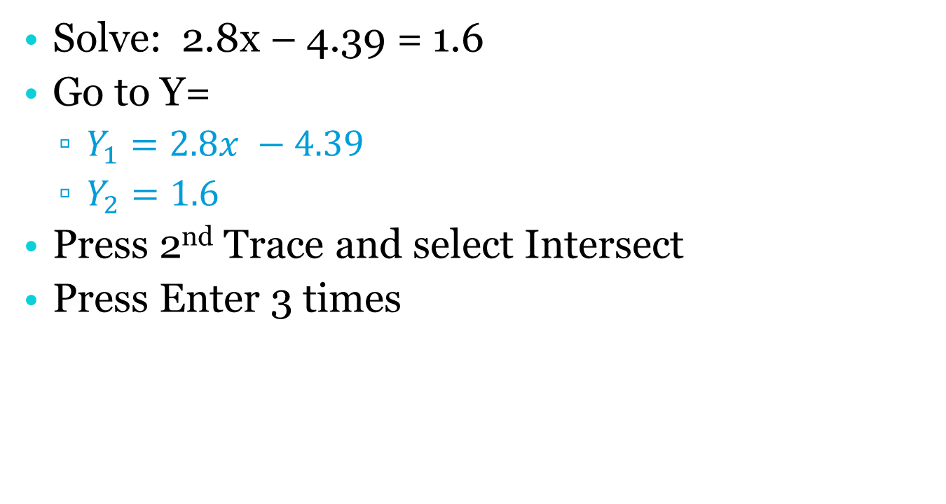
Solving Graphically
Solve: 2.8x – 4.39 = 1.6
Go to Y=
  $Y_{1}=2.8x −4.39$
  $Y_{2}=1.6$
Press 2nd Trace and select Intersect
Press Enter 3 times

Slide 24
Examples
When w grams of weight are placed on a spring balance, the scale reads R mm. The reading is given by the rule R = 0.4w + 5
  R = 27 R = 42

Slide 25
Try These!
P. 100 #1, 2, 4-6

Slide 26
4E: TLW problem solve with linear equations.

Slide 27
Steps to Guide You
Decide what’s unknown and label with variables
What operations do you need to use?
Write an equation.
Solve it.
Write it in a sentence complete with label.
Check it.

Slide 28
When a number is doubled and then subtracted from 3, the result is -17. Find the number.

Slide 29
When a certain number is trebled then decreased by 1, the result is twice as much as 5 more than the number. What’s the number?

Slide 30
Using a box to organize.
Malikah’s mom is presently four times as old as Malikah. In 6 year’s time her mom will be 3 times as old as Malikah is then. How old is Malikah now?
  Need to write equation for the same year.
 | Now | In 6 years
Malikah
Mom

Slide 31
Carl has only 20¢ coins and 50¢ coins in his wallet. He has 3 more 50¢ coins than 20¢, and their total value is $2.90. How many 20¢ coins does Carl have?

Slide 32
You’re on your own, unless you’re nice to me.
P. 101-103 #1-10, CD skip #3 and 7

Slide 33
3F TLW substitute values into formulas.
Formulas connect two or more variables to each other.
What are some formulas you know?

Slide 34
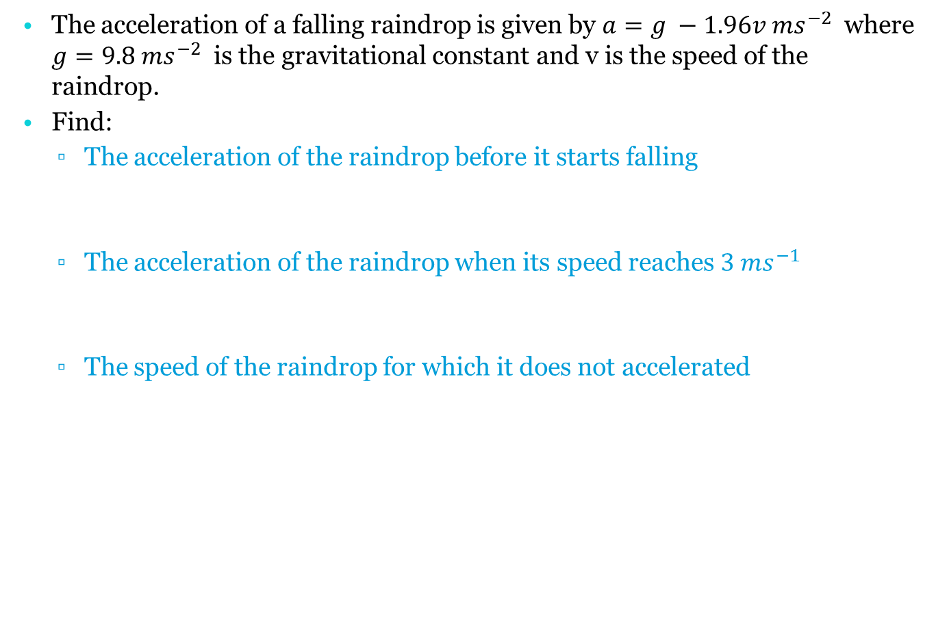
The acceleration of a falling raindrop is given by $a=g −1.96v ms^{−2}$ where $g=9.8 ms^{−2}$ is the gravitational constant and v is the speed of the raindrop.
Find:
  The acceleration of the raindrop before it starts falling
  The acceleration of the raindrop when its speed reaches $3 {ms}^{−1}$
  The speed of the raindrop for which it does not accelerated

Slide 35
Time For You to Shine
P. 104 #1-8

Slide 36
4G: TLW rearrange formulas.
You can rearrange formulas to make equivalent formula that is easier to work with.

Slide 37
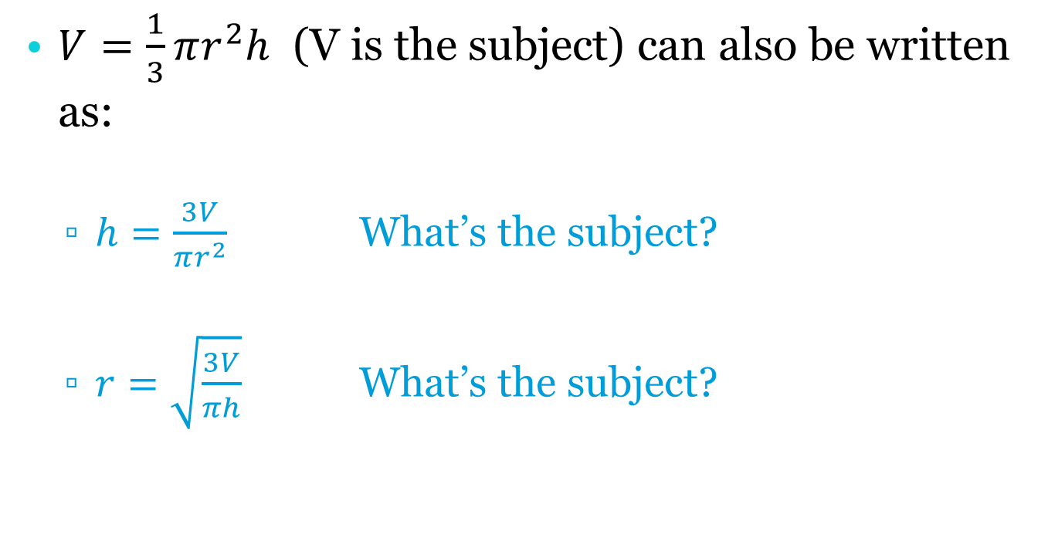
Volume of a Cone
$V=\frac{1}{3}πr^{2}h$ (V is the subject) can also be written as:
  $h=\frac{3V}{πr^{2}}$ What’s the subject?
  $r=\sqrt{\frac{3V}{πh}}$ What’s the subject?

Slide 38
It’s like solving an equation for a variable.
Make y the subject of 3x – 7y = 22

Slide 39
Make x the subject of 7x + 3y = d

Slide 40

Make z the subject of $y=\frac{x}{z}$
Try these: p. 106 #3, 4, 5

Slide 41

Rearrangement and Substitution
Sometimes it helps to rearrange the formula first and then substitute.
Write r as the subject: $C=2πr$
Find the radius when the circumference is:
  10 cm 20 cm

Slide 42
Try These Now!
P, 107 #1-4

Slide 43
4H TLW solve simultaneous equations.
There are many ways to solve simultaneous equations and we will look at a few.
You need to find a solution that must be true for all the equations at the same time
What does the solution represent graphically?

Slide 44

Solving with a GDC (Polysmlt 2)
Solve $\left\{\begin{aligned}2x −3y=4 \\ 3x+2y=19\end{aligned}\right.$

Slide 45

Graphical Method and the GDC
Solve: $\left\{\begin{aligned}y=3x −2 \\ 2x+y=13\end{aligned}\right.$
  Must have all equations with y as the subject.

Slide 46

Algebraic Methods-Substitution
Only use if one equation has x or y as the subject.
Solve: $\left\{\begin{aligned}y=3+x \\ 2x −4y=−16\end{aligned}\right.$

Slide 47

Example
$\left\{\begin{aligned}y=2x+5 \\ 2y=4x+10\end{aligned}\right.$

Slide 48
Elimination
Equations are in ax + by = c format
Get one set of variables with the same size and opposite signs
  Add them together

Slide 49


Example
$\left\{\begin{aligned}2x −3y=4 \\ 3x+2y=19\end{aligned}\right.$
Look for variables with opposi signtes or the same coefficient

Slide 50
Time to Solve
4H.3 p. 111 #1-2 a-c only
4H.4 p. 112 #2-4
Check with GDC!

Slide 51
4I: TLW problem solve using simultaneous equations.

Slide 52
Steps to Help You Solve
What unknowns represent x and y?
Two variables = 2 equations
Solve it.
Check it.
Write your answer in a sentence with labels.

Slide 53
Find two numbers which have a sum of 37 and a difference of 11.

Slide 54
Try These
P. 113 #1 and 2

Slide 55
Two adults’ tickets and three children’s tickets to a baseball match cost $45, while 3 adults’ and 4 children’s tickets cost $64. Find the cost of each type of ticket.

Slide 56
Assignment
CD p.114 #3-6
DP p. 114 #3-10
  Remember: Distance = Rate * Time

Slide 57

Factoring Quadratics
$x^{2}+bx+c$
Why do we factor?
  Solve non linear equations
  Find intercepts

Slide 58

How To…
$$x^{2}+bx+c$$
Find the factors (x + )(x + )
These numbers should multiply to c and add to b.

Slide 59
Examples
$$x^{2}−7x+12$$
(x )(x )

Slide 60
$$x^{2}+3x−10$$

Slide 61
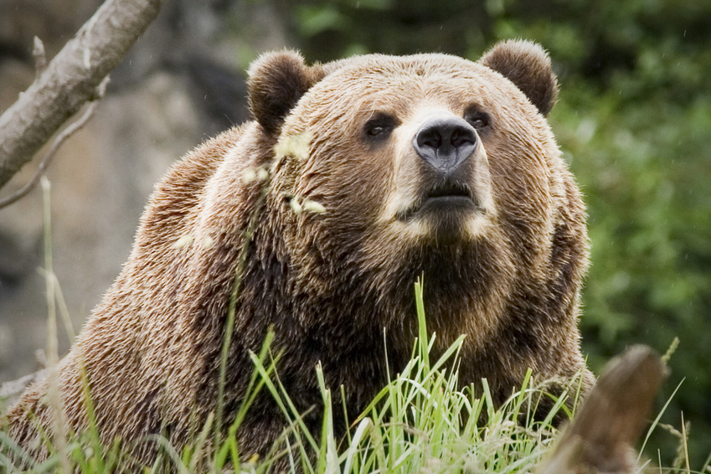

What if $a≠1$?
$ax^{2}+bx+c$
The Youngberg Method

Slide 62
The Youngberg Method
$ax^{2}+bx+c$
Multiply a to c
Factor the new trinomial
Divide off a and reduce fractions
Bottoms UP!
$3x^{2}+5x+2$

Slide 63

4J: TLW solve quadratic equations.
Quadratic: $ax^{2}+bx+c=0, a≠a$
Solutions are called roots or zeros

Slide 64
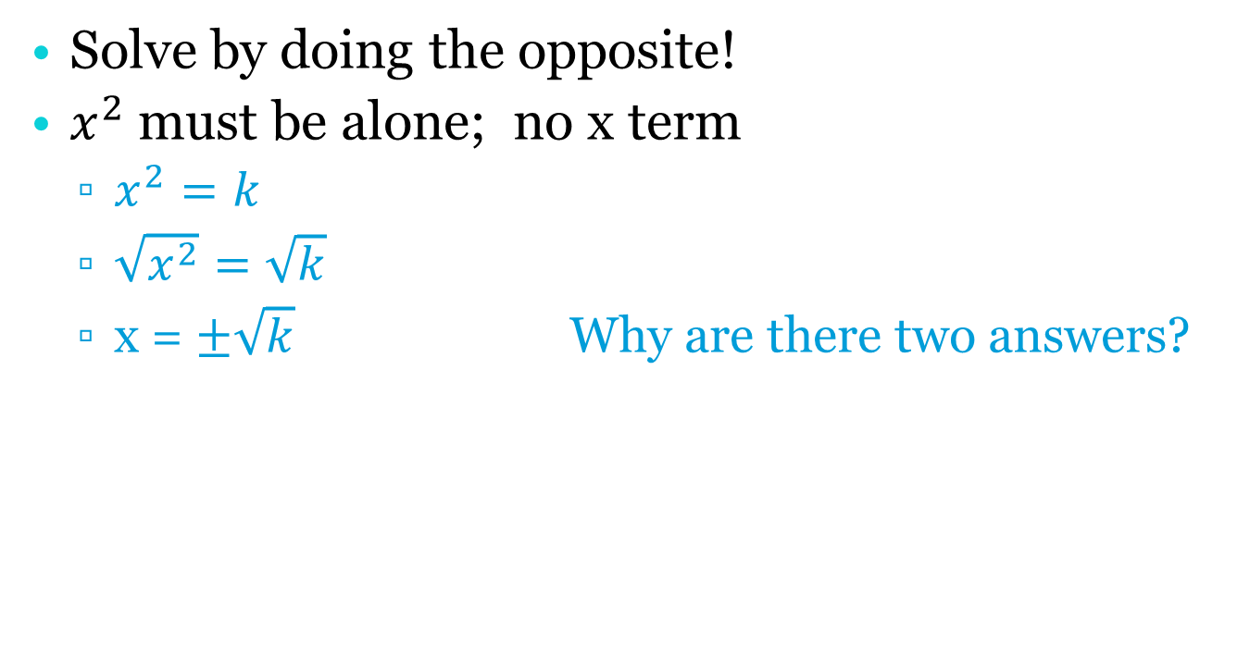

Solving $x^{2}=k$
Solve by doing the opposite!
$x^{2}$must be alone; no x term
  $x^{2}=k$
  $\sqrt{x^{2}}=\sqrt{k}$
  x = $±\sqrt{k}$ Why are there two answers?

Slide 65

Example
Solve: $3x^{2}−1=8$

Slide 66

Example
$5−2x^{2}=11$

Slide 67

Example
${\left(x+3\right)}^{2}=36$

Slide 68

Example
${\left(x−4\right)}^{2}=7$

Slide 69
Try These
4J.1 p. 116 #1a-d, 2a-c, h (DP only)

Slide 70
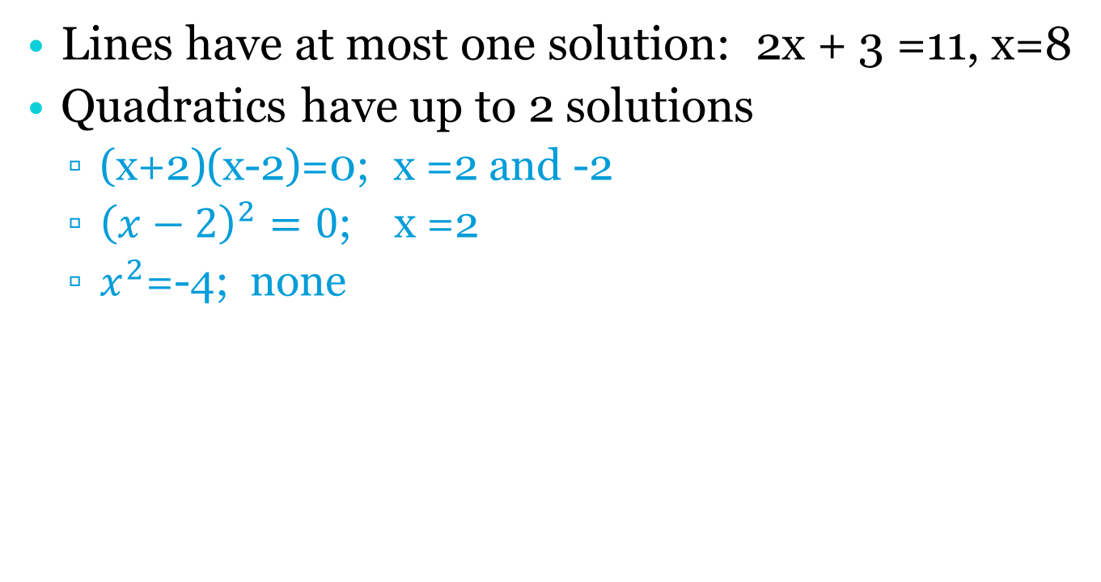
The Null Factor Law
Lines have at most one solution: 2x + 3 =11, x=8
Quadratics have up to 2 solutions
  (x+2)(x-2)=0; x =2 and -2
  ${\left(x−2\right)}^{2}=0$; x =2
  $x^{2}$=-4; none

Slide 71
The Null Facto Law
If a*b = 0, then a = 0 or b = 0
Must factor quadratic
Set each factor = zero
  Example: 3x(x – 5) = 0

Slide 72
Example
(x – 4)(3x + 7)
Assignment: p. 117 4J.2 #1-2

Slide 73

Quadratics and the GDC
Polysmlt 2
Must be in $ax^{2}+bx+c=0$ format
Solve: $2x^{2}+4x=7$
Try p. 118 #1

Slide 74
Example
3(x-1) + x(x +2) =3
  What’s wrong with this picture?

Slide 75
Try These
4J.3 p.118 #3 CD a and b; DP a, b, d

Slide 76

Example
$x\left(3x+\frac{2}{x}=−7\right)$
Try p.119 #4 CD: a and b
DP a, b, d

Slide 77
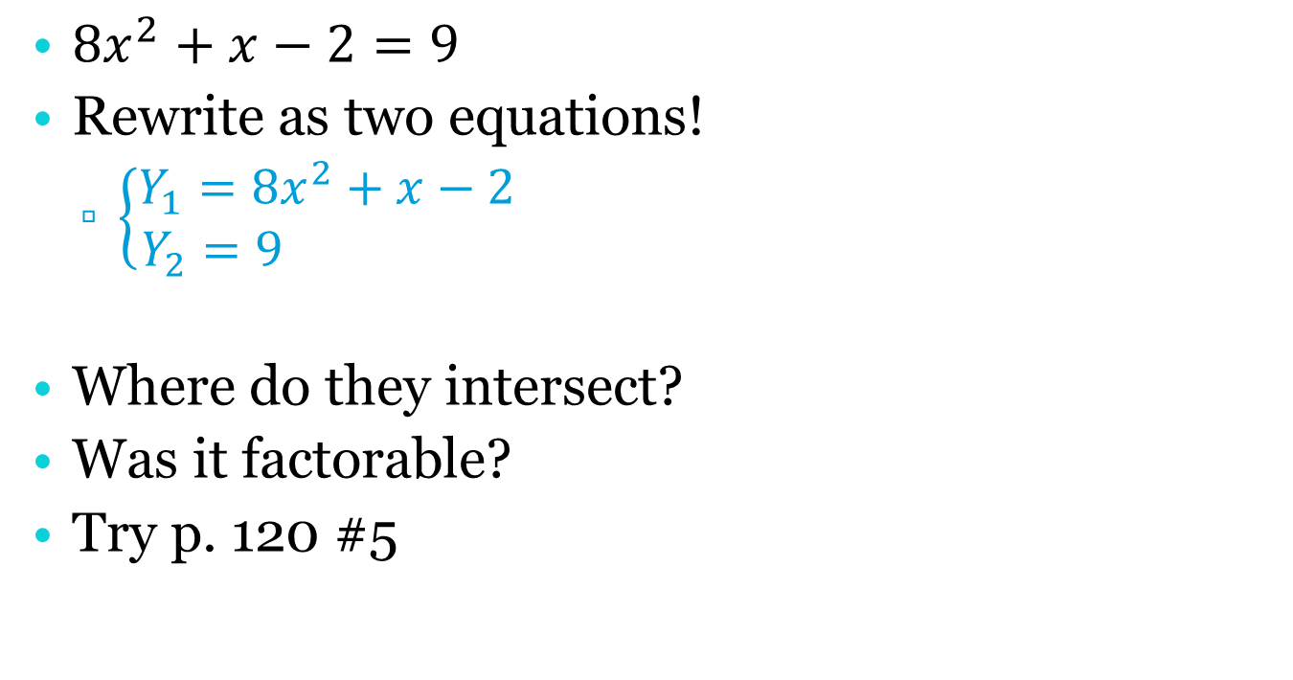
Graphing for Solutions
${8x}^{2}+x−2=9$
Rewrite as two equations!
  $\left\{\begin{aligned}Y_{1}=8x^{2}+x−2 \\ Y_{2}=9 \end{aligned}\right.$
Where do they intersect?
Was it factorable?
Try p. 120 #5

Slide 78

Quadratic Formula
When it’s NOT factorable and no GDC
If $ax^{2}+bx+c=0$, then $x=\frac{−b±\sqrt{b^{2}−4ac}}{2a}$
Substitute
Solve

Slide 79

Example
$x^{2}−2x−6=0$ 2$x^{2}+3x−6=0$

Slide 80
Try These
P.121 CD #1a-f
DP #1, 2a, b
Final assignment: CD p. 121 #1 g-I
DP p. 120 #7, p.121 #1g-i, 2c-f

Slide 81
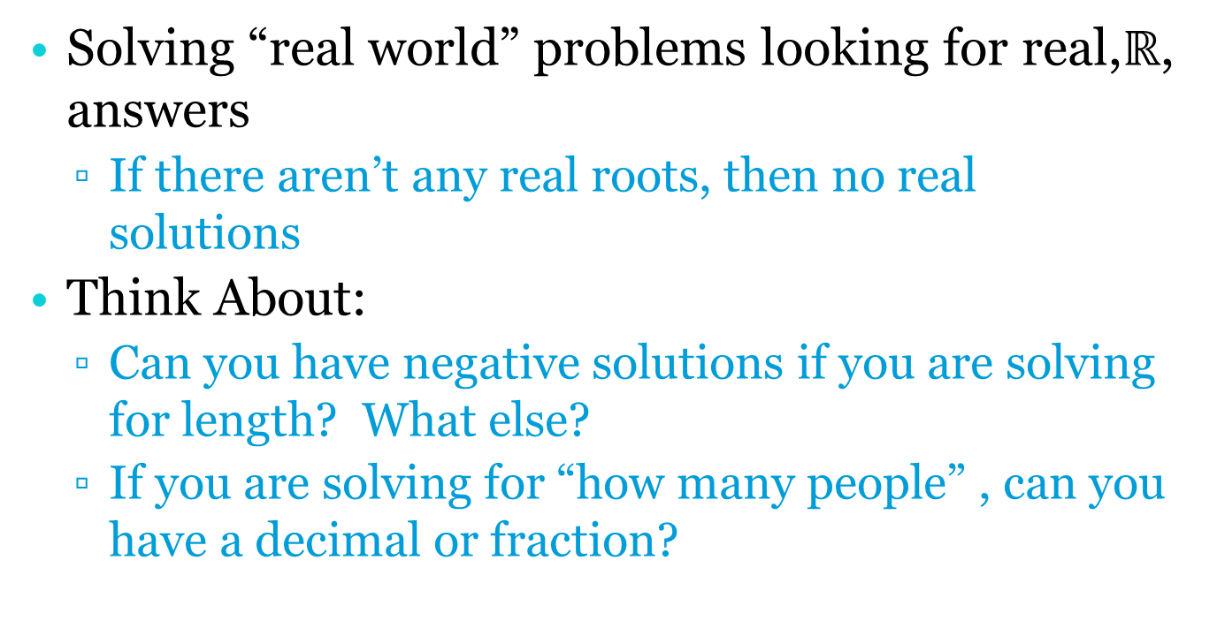
4K: TLW problem solve with quadratics.
Solving “real world” problems looking for real,$ℝ$, answers
  If there aren’t any real roots, then no real solutions
Think About:
  Can you have negative solutions if you are solving for length? What else?
  If you are solving for “how many people” , can you have a decimal or fraction?

Slide 82
Process
Transfer words into an equation
Solve it
Do you have reasonable solutions?
Write answer in a sentence with labels

Slide 83

A rectangle has length 3 cm longer than its width. Its area is 42 ${cm}^{2}.$ Find its width.

Slide 84
Two integers differ by 12 and the sum of their squares is 74. Find the integers.

Slide 85
Assignment
CD p.123 #6-8
DP p.123 #1-8

Slide 86

Is it possible to bend 12 cm length of wire to form the shorter sides of a right triangle with area of 20 ${cm}^{2}$. Use technology to solve.

Slide 87
Assignment
CD p.123 #9, 10, 11
DP p. 123 #9-14

