Slide 1

Chapter 21
Goal: TLW identify increasing and decreasing functions.

Slide 2
Increasing and Decreasing
We will look at the intervals over which a function increases and/or decreases.
Increasing: as x increases then y increases
Decreasing: as x increases then y decreases

Slide 3
Rules
F(x) is increasing if f(a)<f(b) when a <b
F(x) is decreasing if f(a)>f(b) when a<b

Slide 4

Let’s take a look
$y=2^{x}$
$y=3^{−x}$
$y=x^{2}$

Slide 5
Example
Find the intervals where f(x) is:
Increasing
decreasing
(-1, 3)
(2, -4)

Slide 6
Sign Diagrams
Use to help determine intervals where a function is increasing/decreasing
Critical Values: when f’(x) = 0 or f’(x) is undefined.
  Means gradient is zero
  What type of line is the tangent?

Slide 7
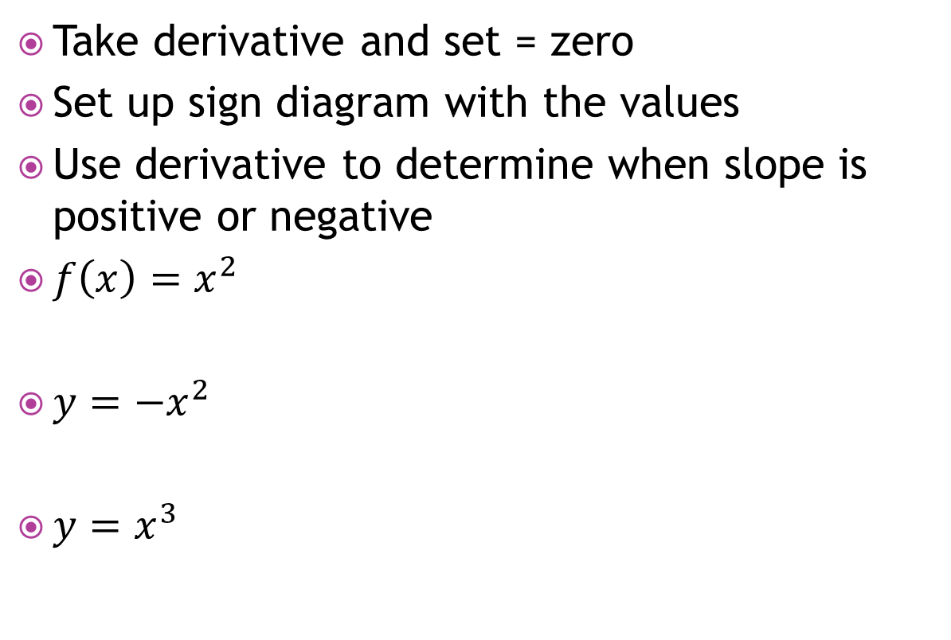
Examples
Take derivative and set = zero
Set up sign diagram with the values
Use derivative to determine when slope is positive or negative
$f\left(x\right)=x^{2}$
$y=−x^{2}$
$y=x^{3}$

Slide 8

Example
Find the intervals where $f\left(x\right)=2x^{3}+3x^{2}−12x−5$ is increasing or decreasing.

Slide 9
Assignment
P.589 #1 all, 2 every other even

Slide 10
21B: TLW find stationary points and interpret them.
A stationary point of a function could be a local maximum, a local minimum or a horizontal inflection

Slide 11
Stationary Points
Global minimum: minimum in entire domain
Local minimum: a turning point; f’(x) = 0
  Slope changes from negative to positive
Global maximum: maximum in entire domain
Local maximum: a turning point; f’(x) =0
  Slope changes from positive to negative
Horizontal or Stationary Point of Inflection:
  Curve doesn’t change shape

Slide 12

Example
Find and classify all stationary points of $f\left(x\right)=x^{3}−3x^{2}−9x$+5.

Slide 13

example
Sometimes the endpoints could be a maximum or minimum.
Find the greatest and least value of $x^{3}−6x^{2}+5$ on the interval $−2≤x≤5.$

Slide 14
Assignment
P.593 #1,2,4, and 5 every other letter, 6-10

Slide 15
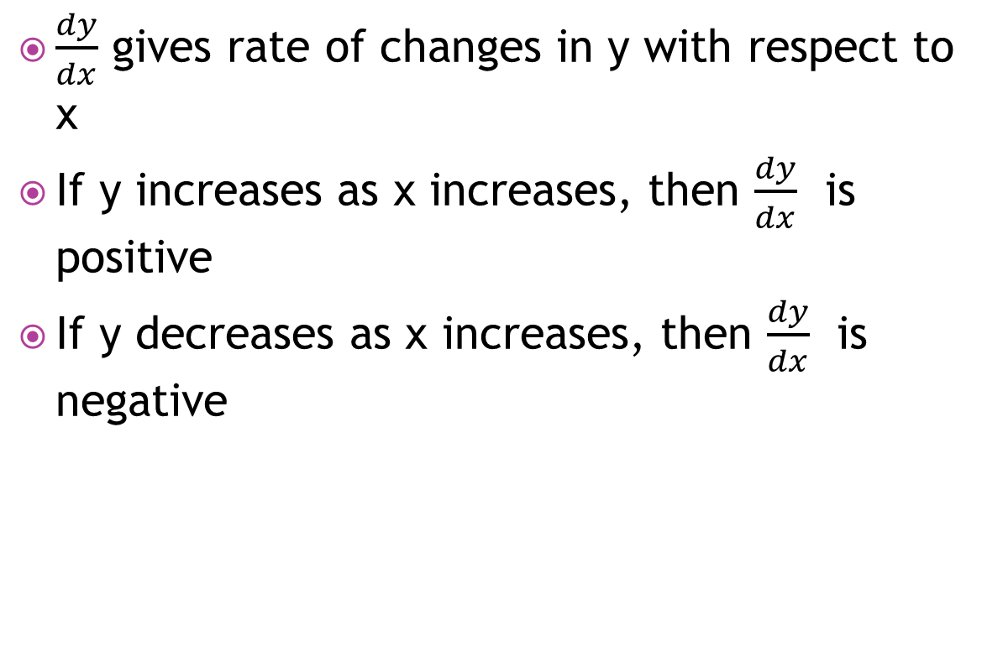
21C: Tlw interpret rates of changes.
$\frac{dy}{dx}$ gives rate of changes in y with respect to x
If y increases as x increases, then $\frac{dy}{dx}$ is positive
If y decreases as x increases, then $\frac{dy}{dx}$ is negative

Slide 16
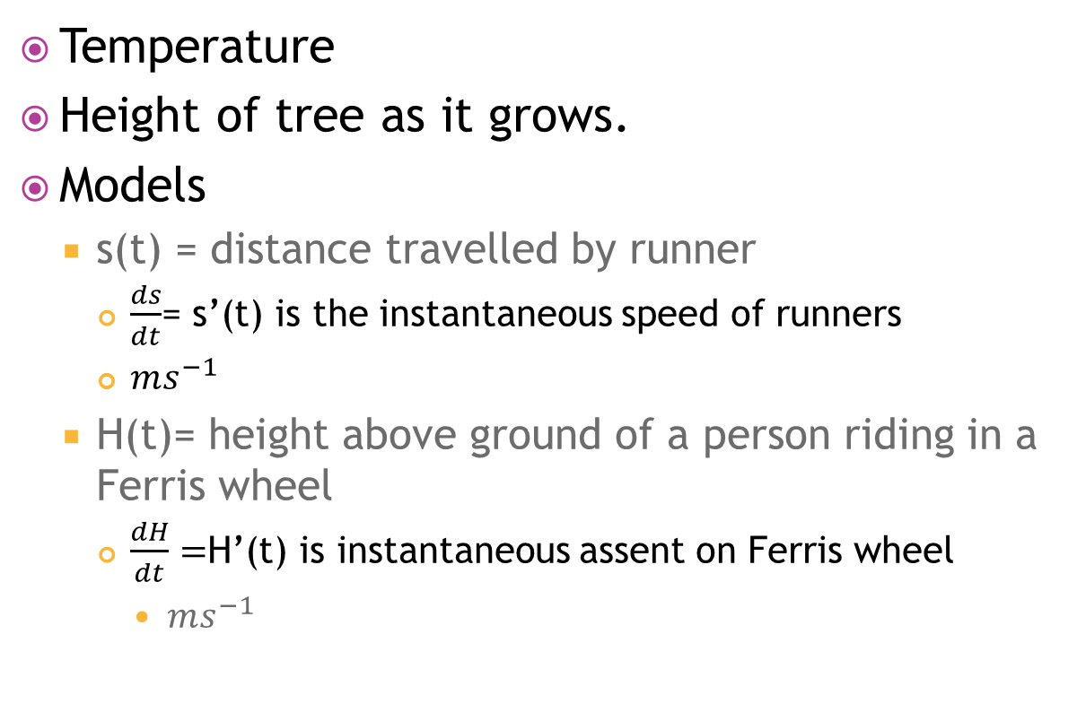
Time rates of changes
Temperature
Height of tree as it grows.
Models
  s(t) = distance travelled by runner
    $\frac{ds}{dt}$= s’(t) is the instantaneous speed of runners
    $ms^{−1}$
  H(t)= height above ground of a person riding in a Ferris wheel
    $\frac{dH}{dt}=$H’(t) is instantaneous assent on Ferris wheel
      $ms^{−1}$

Slide 17
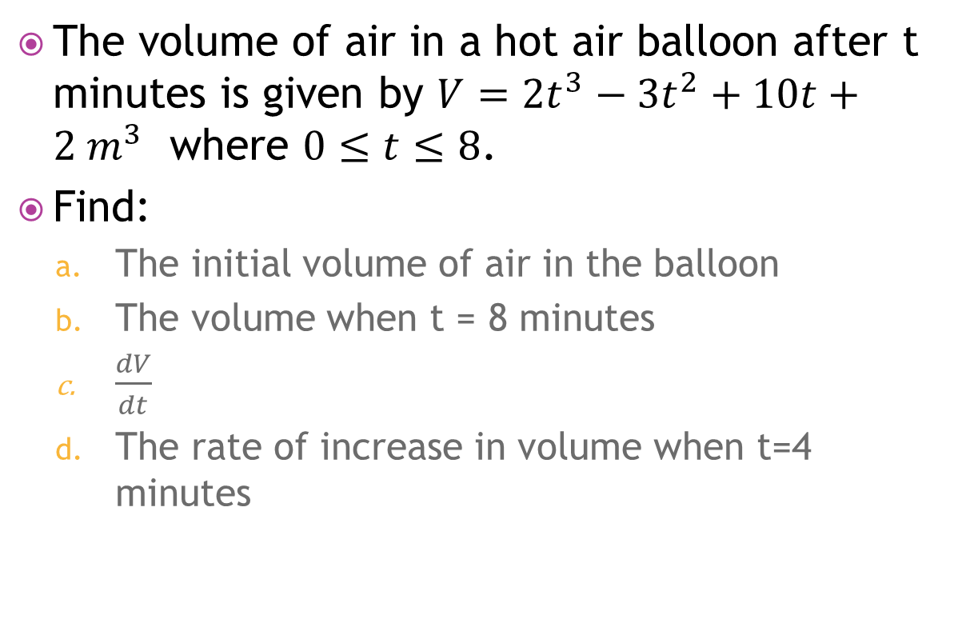
Example
The volume of air in a hot air balloon after t minutes is given by $V=2t^{3}−3t^{2}+10t+2 m^{3}$ where $0≤t≤8$.
Find:
  The initial volume of air in the balloon
  The volume when t = 8 minutes
  $\frac{dV}{dt}$
  The rate of increase in volume when t=4 minutes

Slide 18
Assignment
P. 596 #1-6

Slide 19
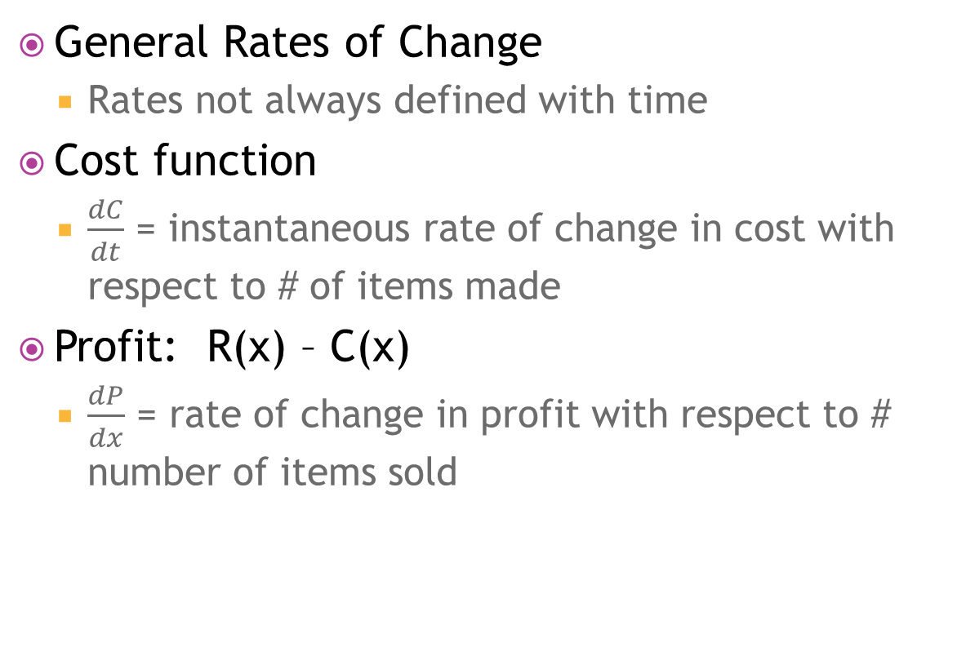
21C continued
General Rates of Change
  Rates not always defined with time
Cost function
  $\frac{dC}{dt}$ = instantaneous rate of change in cost with respect to # of items made
Profit: R(x) – C(x)
  $\frac{dP}{dx}$ = rate of change in profit with respect to # number of items sold

Slide 20
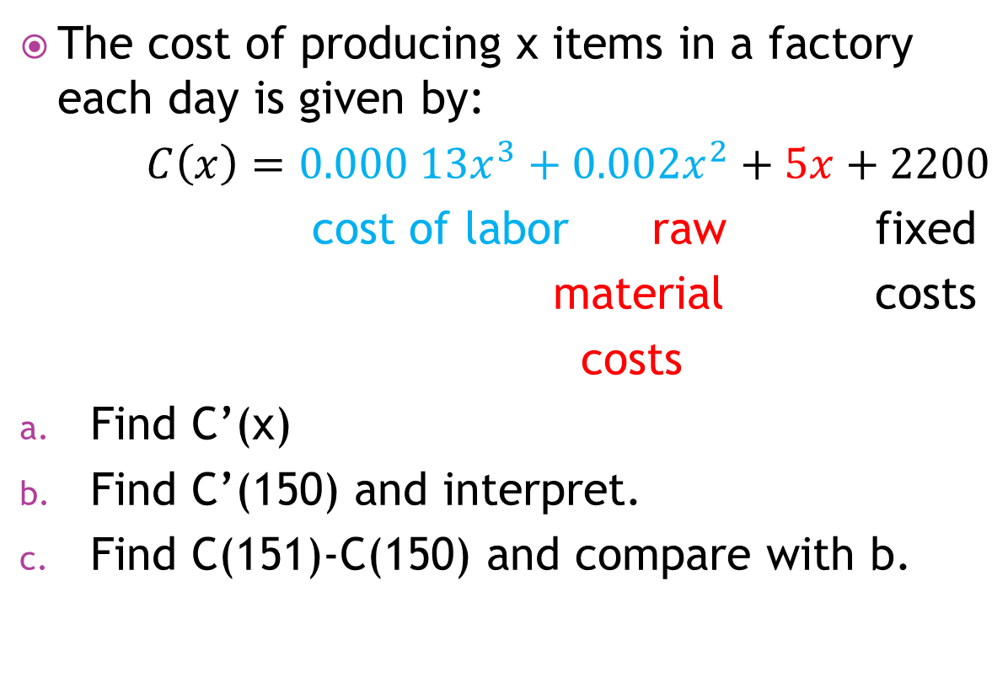
Example
The cost of producing x items in a factory each day is given by:
$C\left(x\right)=0.000 13x^{3}+0.002x^{2}+5x+2200$
cost of labor raw fixed
material costs
costs
Find C’(x)
Find C’(150) and interpret.
Find C(151)-C(150) and compare with b.

Slide 21
Assignment
P. 597 #1-9

Slide 22
21D: optimisation
Sometimes need to find maximum/minimum of a function
Optimum solution
Doesn’t always occur f’(x)=0, also look at endpoints of domain.

Slide 23
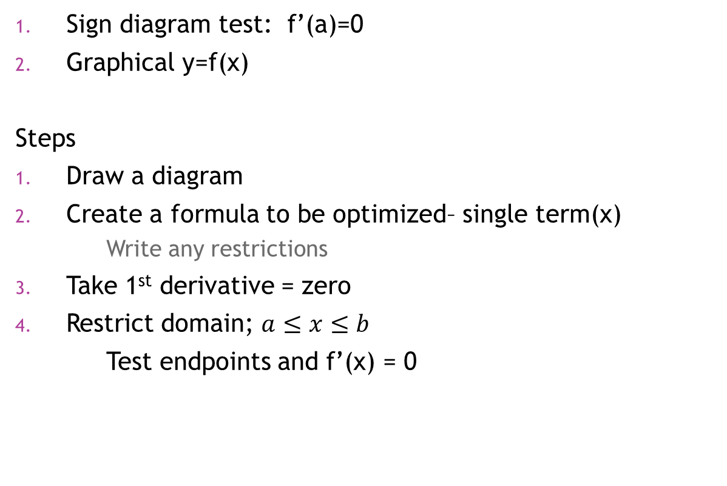
Testing Optimal Solutions
Sign diagram test: f’(a)=0
Graphical y=f(x)
Steps
Draw a diagram
Create a formula to be optimized– single term(x)
  Write any restrictions
Take 1st derivative = zero
Restrict domain; $a≤x≤b$
Test endpoints and f’(x) = 0

Slide 24
Example
A 4 liter container must have a square base, vertical sides and an open top. Find the most economical shape which minimizes the surface area of material needed.
open

Slide 25
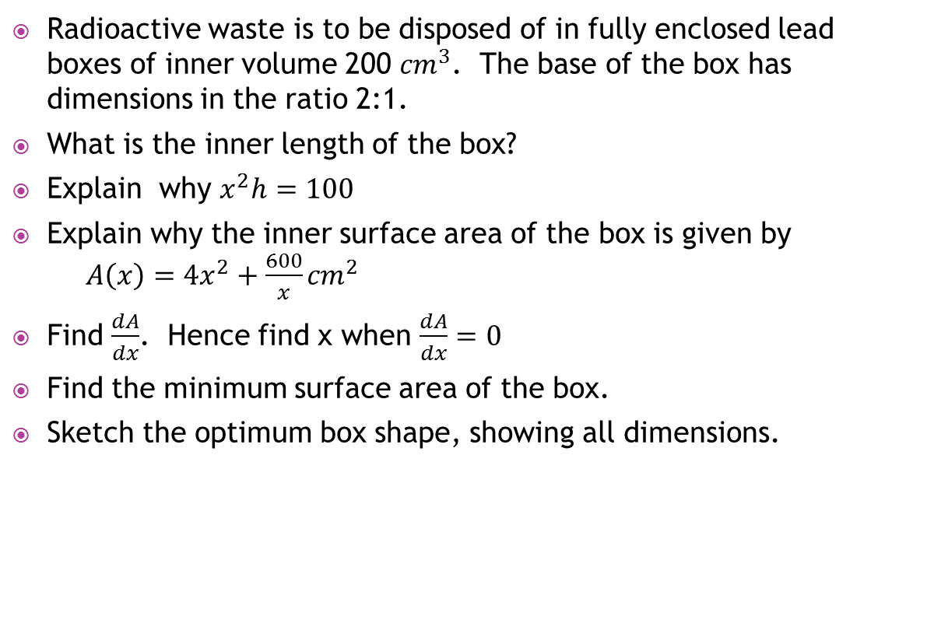
Example p. 601 #8
Radioactive waste is to be disposed of in fully enclosed lead boxes of inner volume 200 ${cm}^{3}$. The base of the box has dimensions in the ratio 2:1.
What is the inner length of the box?
Explain why $x^{2}h=100$
Explain why the inner surface area of the box is given by $A\left(x\right)=4x^{2}+\frac{600}{x}{cm}^{2}$
Find $\frac{dA}{dx}$. Hence find x when $\frac{dA}{dx}=0$
Find the minimum surface area of the box.
Sketch the optimum box shape, showing all dimensions.

Slide 26
Assignment
P.601 #1-9, skip #8

Slide 27
Example
A square sheet of metal 12 cm x 12 cm has smaller squares cut from its corners as shown.
What sized square should be cut out so that when the sheet is bent into an open box it will hold the maximum amount of liquid?
12 cm
12 cm

Slide 28
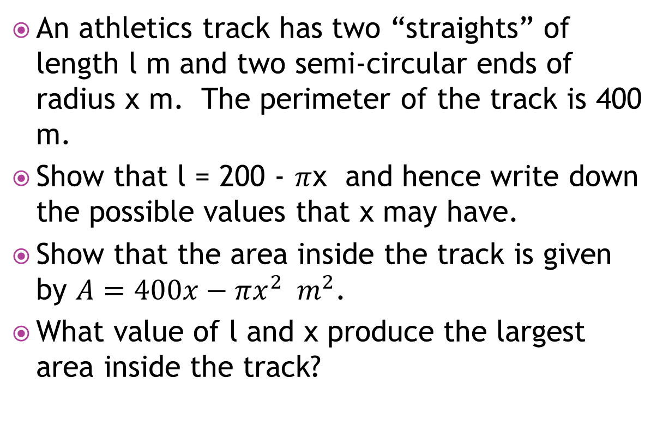
Example p. 603 #11
An athletics track has two “straights” of length l m and two semi-circular ends of radius x m. The perimeter of the track is 400 m.
Show that l = 200 - $π$x and hence write down the possible values that x may have.
Show that the area inside the track is given by $A=400x−πx^{2} m^{2}$.
What value of l and x produce the largest area inside the track?

Slide 29
Assignment
P.603 #10, 13, 14

Slide 30
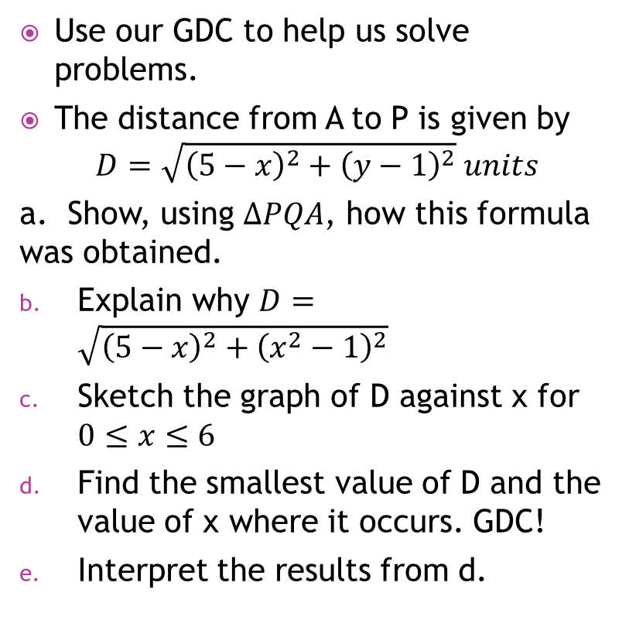
Optimization using technology
Use our GDC to help us solve problems.
The distance from A to P is given by
$$D=\sqrt{{\left(5−x\right)}^{2}+{\left(y−1\right)}^{2}} units$$
a. Show, using $∆PQA$, how this formula was obtained.
Explain why $D=\sqrt{{\left(5−x\right)}^{2}+{\left(x^{2}−1\right)}^{2}}$
Sketch the graph of D against x for $0≤x≤6$
Find the smallest value of D and the value of x where it occurs. GDC!
Interpret the results from d.
P(x,y)
A(5, 1)
Q

Slide 31
A closed pizza box is folded from a sheet of cardboard 64 cm by 40 cm. To do this, equal squares of side length x cm are cut from two corners of the short side, and two equal rectangles of width x cm are cut from the long side as shown.
Find the dimensions of the lid and the base of the box in terms of x.
Find the volume of the box in terms of x.
What is the maximum possible volume of the box?
What are the dimensions of the box which has the maximum volume?

Slide 32
Theory of Knowledge
p. 606

Slide 33
Assignment
P,604-605 #1, 2, 4, 5

