Slide 1
Chapter 20 Differential Calculus
20A: TLW describe rates of change.

Slide 2
Rate: comparison between two quantities of different kinds.
Speed: $kmh^{−1}$
Fuel Efficiency: $kmL^{−1}$
Scoring Rate: points per grade

Slide 3
Example
Josef typed 213 words in 3 minutes and made 6 errors, whereas Marie typed 260 words in 4 minutes and made 7 errors. Compare their performance using rates.
Josef’s typing rate
Josef’s error rate
Marie’s typing rate
Marie’s error rate

Slide 4
Assignment
P.560 #1-5 odds

Slide 5
Investigation 1 p. 561
..\Math Studies Book\contents\demos\136.exe

Slide 6
Average Rate of Change
Straight line: constant rate of change in one quantity with respect to the other
Curve line: can find average rate of change between two points by finding gradient of chord.
Will vary depending on two points picked
Need to focus on an interval

Slide 7
Eample 2
The number of mice in a colony was recorded on a weekly basis.
Estimate the average rate of increase in population for:
The period from week 3 to week 6
The seven week period
What is the overall trend in the population growth over this period?

Slide 8
Assignment
P.563 #1-2

Slide 9
20B: TLW find instantaneous rates of change.
Investigation 2
..\Math Studies Book\contents\demos\242.exe

Slide 10
Instantaneous Rate of Change
Speed of an object at a particular instant.
Rate of change is the gradient of the tangent to the graph at that point.

Slide 11
Assignment
P.565 #1-2

Slide 12
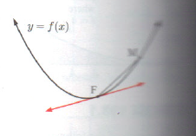
Finding the gradient of a tangent algebraically
Previously drew in a tangent and approximated the gradient.

Slide 13
Investigation 3
P. 566
Let’s do this together.

Slide 14
Simplify
$\frac{1}{x+2}−\frac{1}{x}$
$\frac{2}{x−1}+\frac{3}{x}$

Slide 15
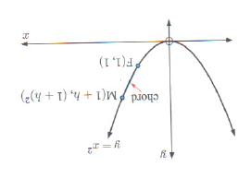
The Algebraic Method
Gradient of FM = $\frac{{\left(1+h\right)}^{2}−1}{\left(1+h\right)−1}$
As M gets closer to F, then h gets closer to 0, so the 2 + h gets closer to 2.

Slide 16
Example
Use the algebraic method to find the gradient of the tangent to $y=x^{2}$ at the point where x = 2.

Slide 17
Assignment
P. 568 #1 every other letter, 2-4

Slide 18
Write without a denominator
$\frac{1}{x^{2}}$
$\frac{4}{x^{4}}$

Slide 19
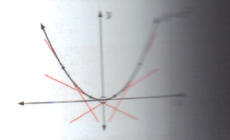
20C: TLW find the derivative of a function.
Non linear function
Gradient is different as you move along the curve.
Gradient function for any x, find gradient
Derived function/Derivative

Slide 20
Derivative
Given y in terms of x, we represent it by
$\frac{dy}{dx}$
f(x) derivative is f’(x)

Slide 21
Finding the derivative
We know that the gradient to $y=x^{2}$ at (x,y) is 2x.
Rule: $y=x^{n}$, then $\frac{dy}{dx}=nx^{n−1}$
What if n = 0?
It disappears!

Slide 22
Find the derivative!
y=3
$y=x^{8}$
$y=\frac{1}{x^{6}}$

Slide 23
Example
$f\left(x\right)=\frac{1}{x^{2}}$
Find f’(x)
Find f’(1)
What does this represent?

Slide 24
Together
P.571 #1b and 3
On your own: p. 571 #1a, c, d, 2, 4

Slide 25
Rules for Differentiation
Process for finding the gradient of a function.
Rules:
Function | f(x) | f’(x)
A constant | a | 0
$$x^{n}$$ | $$x^{n}$$ | $${nx}^{n−1}$$
A constant multiple of $x^{n}$ | $$ax^{n}$$ | $${anx}^{n−1}$$
Multiple terms | u(x) +v(x) | u‘(x) + v’(x)

Slide 26
Examples
Find f’(x): $5x^{3}+6x^{2}−3x$+2
Find f’(x): $7x−\frac{4}{x}+\frac{3}{x^{3}}$

Slide 27
Example
$f\left(x\right)=\frac{x^{2}+4x−5}{x}$, find f’(x).

Slide 28
Assignment
P. 573 #1-3

Slide 29
Finding the gradient of a function.
Find the gradient function of $f\left(x\right)=x^{2}−\frac{4}{x}$
Find the gradient of the tangent to the function at the point where x = 2.

Slide 30
Assignment
P.572 #4 all

Slide 31
Use the GDC to find the gradient of the tangent.
Use your GDC to find the gradient of the tangent to $y=x^{3}+3$ at the point where x = -2.
Steps:
Graph the function
2nd Trace and choose 6:dy/dx
Enter in the value; -2 press ENTER

Slide 32
Example
Consider the function $f\left(x\right)={\left(3x+1\right)}^{2}$
Expand the brackets of ${\left(3x+1\right)}^{2}$
Hence find f’(x)
Hence find the gradient of the tangent to y = f(x) at the point where x = -2 without the GDC.
Check your answer with the GDC.

Slide 33
Example
If $y=3x^{2}−4$x, find $\frac{dy}{dx}$ and interpret its meaning.

Slide 34
Example
At what point on the graph of $y=2x^{2}+5x−3$ does the tangent have gradient 13?
How is this different than other questions we’ve done?

Slide 35
Assignment
P.574-576 #6-12

Slide 36
Example
The tangent to $f\left(x\right)=2x^{2}−ax+b$ at the point (2,7) has a gradient of 3. Find a and b.

Slide 37
Assignment
P.576 #13-16

Slide 38
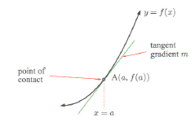
20E: TLW find the equation of tangents.
Find the equation of tangent line.
Find the gradient at the point A.
Substitute gradient and point A into y=mx+b to find b.

Slide 39
Example
Find the equation of the tangent to $f\left(x\right)=x^{2}+1$ at the point where x=1.

Slide 40
Example
Use technology to find the equation of the tangent to $y=x^{3}−7x+3$
Enter graph in Y=
2nd PRGM and choose 5:Tangent(
Type in 2 and press ENTER

Slide 41
Assignment
P.578 #1a-f without GDC and g-j with GDC.

Slide 42
Example
Consider the curve $y=x^{3}−4x^{2}−6x+8$
Find the equation of the tangent to this curve at the point where x = 0.
At what point does this tangent meet the curve again?

Slide 43
Assignment
P.578 #2 and 3 every other letter, 4
DP also does 5

Slide 44
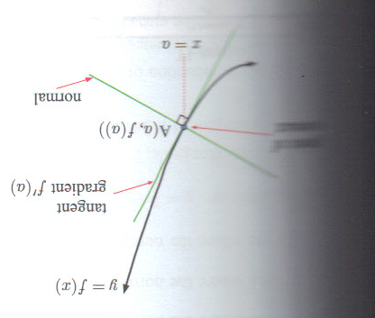
20F TLW find normals to curves
A normal to a curve is a line which is perpendicular to the tangent at the point of contact.
The gradient of a normal at x = a is $−\frac{1}{f^{′}(a)}$.
The tangent line and normal line are perpendicular!

Slide 45
Example
Find the equation of the normal to
$f\left(x\right)=x^{2}−4x+3$ at x = 4.

Slide 46
Example
Find the equation of the normal to: $y=2x^{3}−3x+1$ at x = 1.

Slide 47
Example
Find the coordinates of the point where the normal to $y=x^{2}−3$ at (1, -2) meets the curve again.
That means find the other point of intersection!

Slide 48
Example
Find the coordinates of the point where the normal to $y=x^{3}−12x+2$ at x = -2 meets the x-axis.

Slide 49
Assignment
P.581 #1a, c, e, 2-6, skip 4a
Read over Theory of Knowledge p. 582

