Slide 1
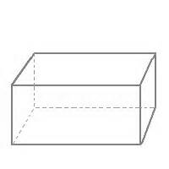
Warm Up
C
H
G
2 cm
For the solid shown, find:
  The length of AE
  The length of BE
B
D
E
3 cm
A
F
6 cm

Slide 2
Perimeter, Area, and Volume
Chapter 14

Slide 3
14A Conversion of Units
Metric
K H D l d c m
g
m
Ex. 16.73 m = ________cm 2.3 kg = __________ g
48 380 cm = __________ km

Slide 4
Try These!
P.414 #1e, 2d, 3, 4, 6

Slide 5

14B Perimeter
Distance around a figure
Units
Square = 4s
Rectangle = 2l + 2w
Circle = $2πr=πd$

Slide 6
Example
Find the perimeter.
4.3 m
(x-4) cm
13.9 m
3x cm

Slide 7
Example
Find, to 3 significant figures, the perimeter of:
4.2 m
10.8 m

Slide 8
Example
Find the radius of a circle with circumference 11.7 m.

Slide 9
Assignment
P.416-418 #2, 4, 5, 6b, c, 9, 10, 11

Slide 10

14C Area
The number of square units contained in a closed figure.
${units}^{2}$
Area Units

Slide 11

Convert
650 000 $m^{2}$ into ha
2.5 $m^{2}$ into ${mm}^{2}$
Try These: p. 419 #1a, c, e, g, 2

Slide 12
Area Formulae

Slide 13
Example 7
Find to 3 significant figures, the area of the following figures:
4.92 m
8.7 cm
7.36 m

Slide 14
Example 8
Calculate the shaded area:
5.3 m
2.1 cm
3.2 m
4.5 cm
8.6 m
7.8 cm

Slide 15
Assignment
P. 420-422 #2, 3, 4, 5, 6a, 6b, 7, 8

Slide 16

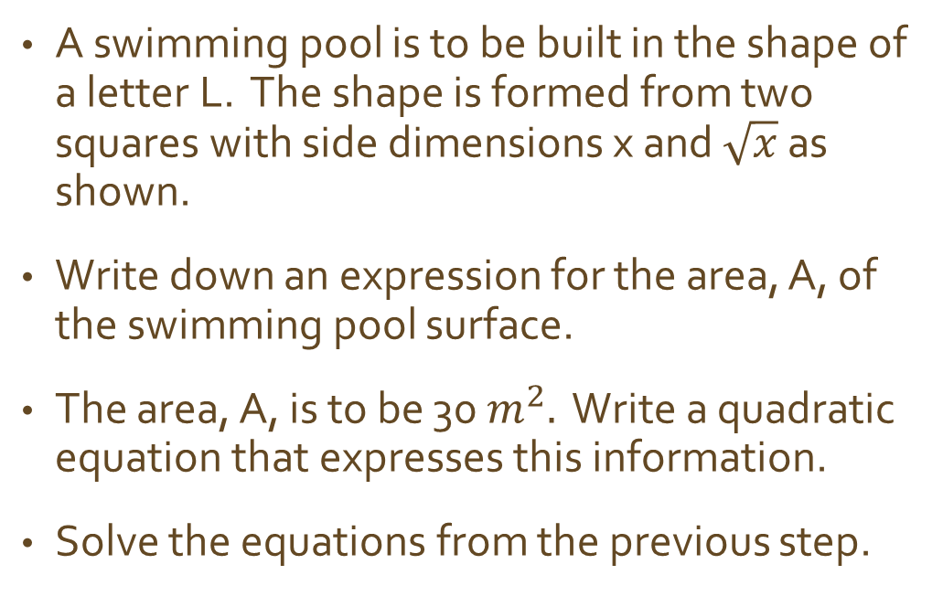

Warm Up
x
A swimming pool is to be built in the shape of a letter L. The shape is formed from two squares with side dimensions x and $\sqrt{x}$ as shown.
Write down an expression for the area, A, of the swimming pool surface.
The area, A, is to be 30 $m^{2}.$ Write a quadratic equation that expresses this information.
Solve the equations from the previous step.
x
$\sqrt{x}$
$\sqrt{x}$

Slide 17
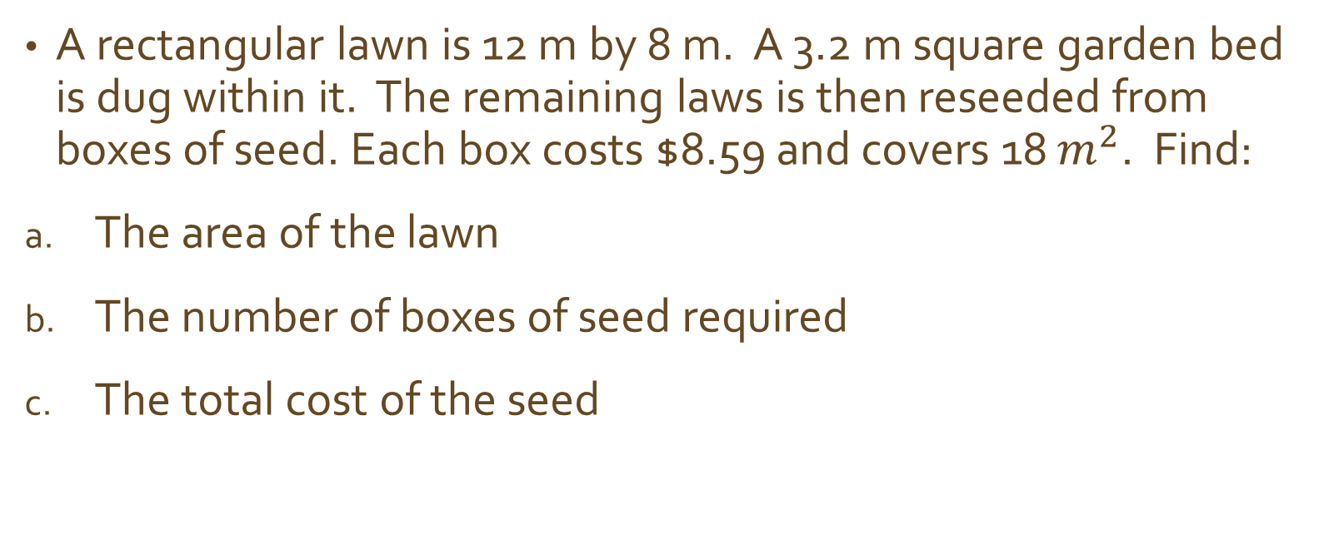
Example
A rectangular lawn is 12 m by 8 m. A 3.2 m square garden bed is dug within it. The remaining laws is then reseeded from boxes of seed. Each box costs $8.59 and covers 18 $m^{2}$. Find:
The area of the lawn
The number of boxes of seed required
The total cost of the seed

Slide 18
Assignment
P. 423 #10-12

Slide 19
Warm Up
Find the perimeter of the figure.
4 cm
4 cm

Slide 20
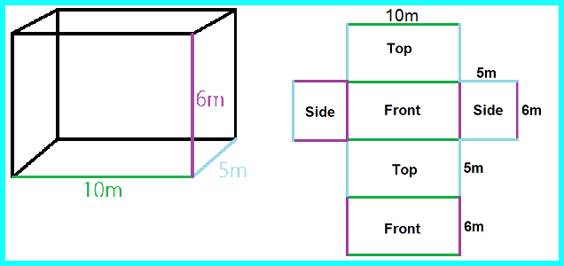
14D Surface Area
The sum of all the areas of the faces of a 3-D figure.

Slide 21
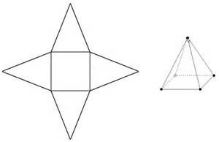
Example
Find the surface area of this square-based pyramid.
Best to break the figure into its faces.
22.4 cm
13.2 cm

Slide 22
Assignment
P.424 #1b, 1c, 2a, 3b, 4, 5

Slide 23
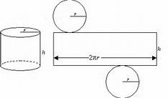
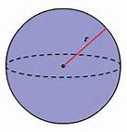
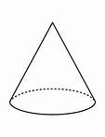
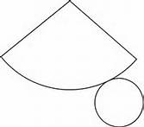



Cylinders, Spheres, and Cones
Cylinder Sphere Cone
$$A=4πr^{2}$$
$$A=πrl+ πr^{2}$$
Note: The formula book does not give you the surface area formulas. I gives you the lateral surface area and you have to remember the circles.

Slide 24
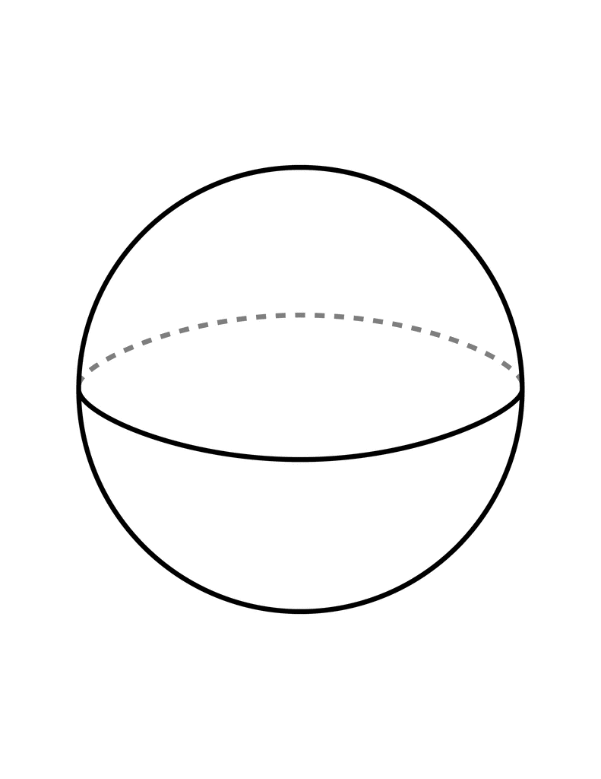
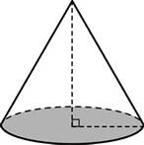

Example: Find the outer surface area, to 1 d.p.
12 cm
8 cm
15 cm
5 cm
6 cm

Slide 25
Assignment
P. 426 #1a, 1c, 1f, 2-6

Slide 26
14E Volume
Amount of space a solid figure occupies.
Cubic units

Slide 27

Common units
I try to convert units before I start.
$1 {cm}^{3}=10 mm x 10 mm x 10 mm=1000{mm}^{3}$
$1 m^{3}=100 cm x 100 cm x 100 cm=1,000,000 {cm}^{3}$
1 cm
1 cm
1 cm

Slide 28

Example
Convert $0.137 m^{3} to {cm}^{3}$.

Slide 29

Example
A steel ball bearing has volume 0.27 ${cm}^{3}$. If the manufacturer has 1.35 $m^{3}$ of steel, how many ball bearings can be made?

Slide 30
Assignment
P.429 #2a, 2e, 2g, 3b

Slide 31
Uniform Solids
Volume = Area of the base x Height

Slide 32
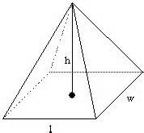
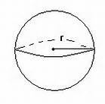
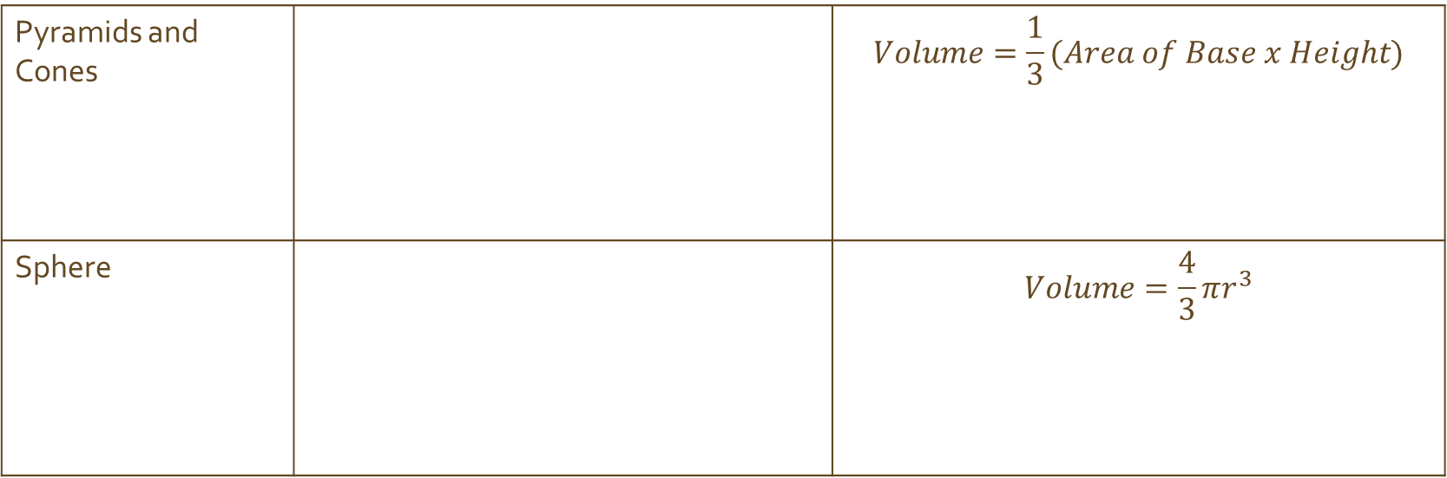
Other solids
Pyramids and Cones |  | $$Volume=\frac{1}{3}(Area of Base x Height)$$
Sphere |  | $$Volume=\frac{4}{3}πr^{3}$$

Slide 33
Example
Find the volume.
36 mm
6.8 cm
45 mm
2.3 cm
5.1 cm

Slide 34
Assignment
P.430-431 #1a,1b,1d, 2b, 2d, 2e, 2g, 2k, 2l, 3

Slide 35

Example
A box has a square base and its height is 12 cm. If the volume of the box is 867 ${cm}^{3}$, find the length of the base.

Slide 36

Example
Find, to 2 significant figures, the radius r of a cylinder with height 3.9 cm and volume 54.03 ${cm}^{3}$.

Slide 37
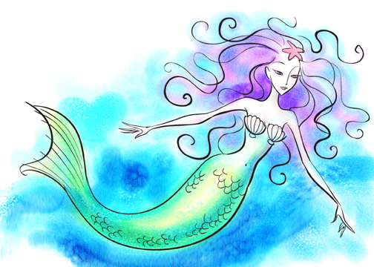
Assignment
P. 432-434 #5, 6, 7, 8, 10, 11, 12

Slide 38

Warm Up
H
G
The diagram shows a cuboid which measures 22.5 cm by 30 cm by 40 cm.
Find the length of AC
Find the area of plane ACGE
Find the volume of the triangular prism ACGEFB
Find the length of CE
E
F
40 cm
C
D
30 cm
A 22.5 cm B

Slide 39
14F Capacity
The quantity of fluid a container is capable of holding.
kL L mL
x 1000
x 1000
Convert:
3.7 L into mL
57,620 L into kL
÷ 1000
÷ 1000

Slide 40

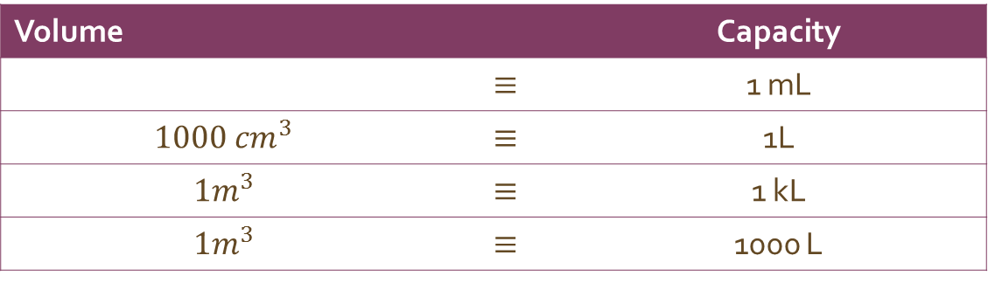
Volume-Capacity Connection
Volume |  | Capacity
 | $$≡$$ | 1 mL
$$1000 {cm}^{3}$$ | $$≡$$ | 1L
$$1m^{3}$$ | $$≡$$ | 1 kL
$$1m^{3}$$ | $$≡$$ | 1000 L
$$1{cm}^{3}$$

Slide 41

Example
Convert:
9.6 L into ${cm}^{3}$
3240 L into $m^{3}$

Slide 42
Assignment
P.435 #1a, 1c, 1e, 2, 3a, 3c, 3e

Slide 43
Example
Find how many kL of water it takes to fill a 2.6 m by 3.1 m by 1.45 m tank.

Slide 44
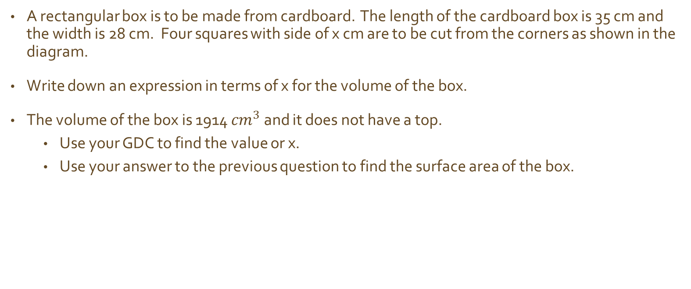
Warm UP
A rectangular box is to be made from cardboard. The length of the cardboard box is 35 cm and the width is 28 cm. Four squares with side of x cm are to be cut from the corners as shown in the diagram.
Write down an expression in terms of x for the volume of the box.
The volume of the box is 1914 ${cm}^{3}$ and it does not have a top.
  Use your GDC to find the value or x.
  Use your answer to the previous question to find the surface area of the box.

Slide 45
Example
17.3 mm of rain falls on a flat rectangular shed roof of length 10 m and width 6.5 m. All of the water goes into a cylindrical tank with base diameter 4 m. By how many millimeters does the water level in the tank rise?
For the roof:
For the tank:

Slide 46
Assignment
P. 435-437 #5-11

Slide 47
14H Harder Applications
A feed silo is made out of sheet steel 3 mm thick using a hemisphere, a cylinder, and a cone.
Explain why the height of the cone must be 70 cm, and hence find the slant height of the conical section.
Calculate the surface area of each of the three sections, and hence show that the total amount of steel used is about 15.7 square meters.
Show that the silo would hold about 5.2 cubic meters of grain when completely full.

Slide 48
Assignment
P.439-440 #2, 3

Slide 49
Warm Up
Line S has equation 2x + y = -2
Write down the gradient of S.
Line T is parallel to line S and passes through A(1,4). Find the equation of line T. Write it as ax + by + d = 0.

