Slide 1
Chapter 13
Coordinate Geometry
Read TOK p. 376

Slide 2
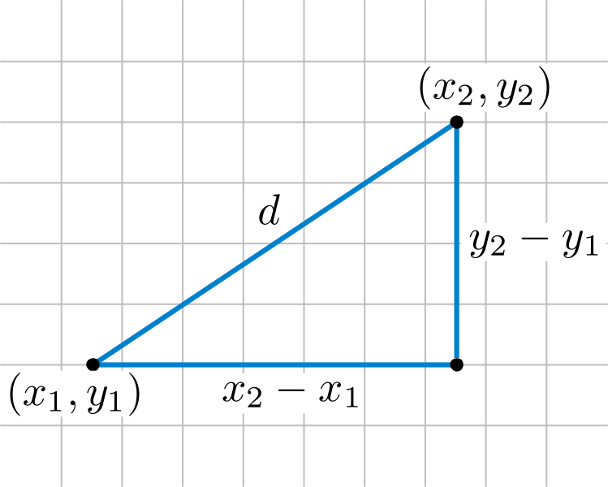
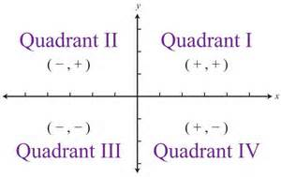

Coordinate Plane

Slide 3
Find the Distance between the points.
A(6, 3) and B(8, -2)

Slide 4
Examples
Use the points A(2, -1), B(5, 1) and C(0, 2) form a triangle ABC.
Use the distance formula to classify the triangle as equilateral, isosceles or scalene.
Does the triangle have a right angle?

Slide 5

Example
Find q given that P(-2, 4) and Q(-1, q) are $\sqrt{10}$ units apart.

Slide 6
Assignment
P. 378-380 #2, 3, 6, 7

Slide 7

13B: Midpoints
$\left(\frac{x_{1}+x_{2}}{2},\frac{y_{1}+y_{2}}{2}\right)=Midpoint$
Example: Find the midpoint A(-1, 3) and B(5, -2).

Slide 8
Example
M is the midpoint of AB. If A is (-1, 4) and M is (2, 3), find the coordinates of B.

Slide 9
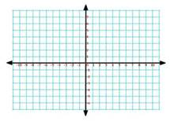
Example
M is the midpoint of AB. Use equal steps to find the coordinates of B, given A is (-4, 3) and M is (-1, 2).

Slide 10
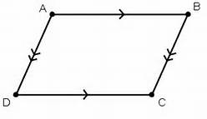
Example
Use midpoints to find the fourth vertex of the given parallelogram:
A(-3, 4) B (1,3)
C(0, -2)

Slide 11
Assignment
P. 381-383 #3a, b, 4a, c, e, 6a, 7, 9, 11, 12a, 13

Slide 12
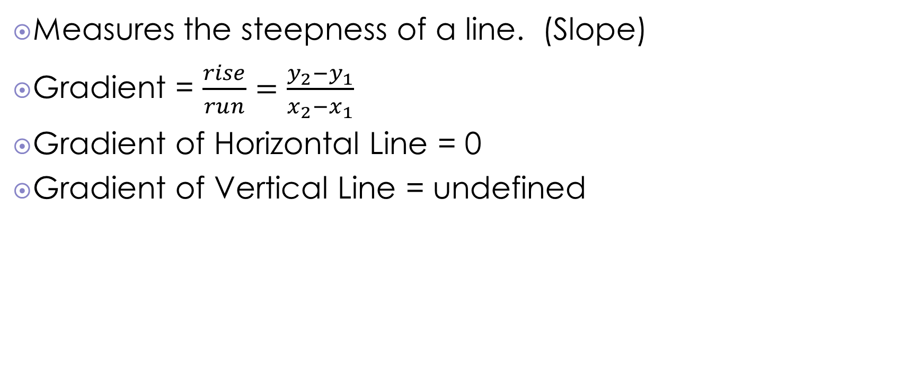
13C Gradient
Measures the steepness of a line. (Slope)
Gradient = $\frac{rise}{run}=\frac{y_{2}−y_{1}}{x_{2}−x_{1}}$
Gradient of Horizontal Line = 0
Gradient of Vertical Line = undefined

Slide 13
Example

Slide 14
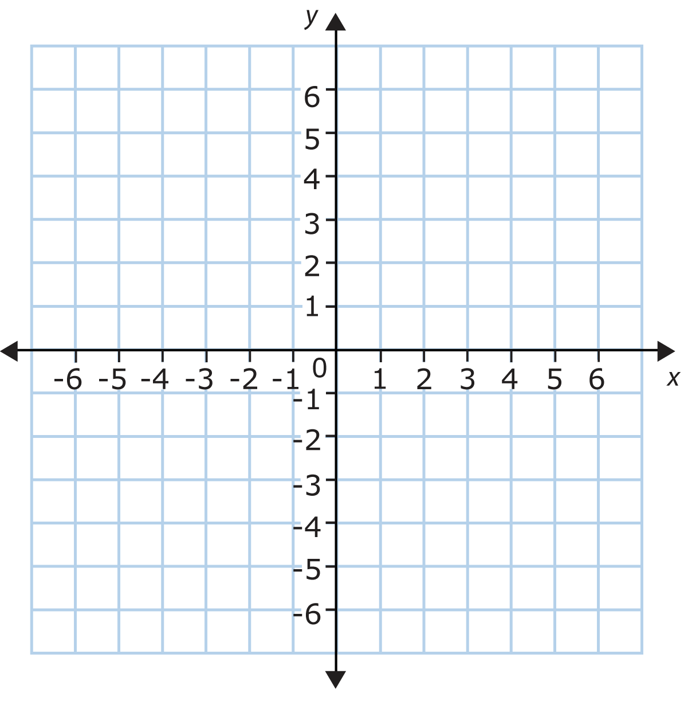

Example
Draw a line through (1, 3) with gradient $−\frac{1}{3}$.

Slide 15
Example
Find the gradient of (-2, 1) and (2, 9).

Slide 16
Example
Find a given that the line joining P(a, -4) to Q(1, 8) has gradient 3.

Slide 17
Assignment
P.385-386 #1, 4, p. 387 #1a, d, g, #2a, c, e, 3, 4

Slide 18

13D Parallel and Perpendicular Lines
Parallel Lines: same slope
Perpendicular Lines: slopes are opposite reciprocals
  Ex. 2 and $−\frac{1}{2}$
  Ex. $−\frac{3}{2} and \frac{2}{3}$
$l_{1}⊥l_{2}$ then $m_{1}∗m_{2}=−1$

Slide 19

Example
If a line has gradient $\frac{2}{5},$ find the gradient of all lines
  Parallel to the given line
  Perpendicular to the given line.

Slide 20

Example
Find t given that the line joining A(1, 4) to B(5, t) is perpendicular to the line with gradient $\frac{2}{3}$.

Slide 21
Collinear Points
3 or more points on the same line.
  Why must it be 3 or more points?
Show that the points A(-5, -3), B(-1, -1) and C(7, 3) are collinear.

Slide 22
Assignment
P. 389 #1-8

Slide 23
Find the equation of parallel lines.
Find an equation of a line parallel to 3x +4y = 6 and passing through (8, -1)

Slide 24
Find the equation of a perpendicular line.
Find the line perpendicular to 3x + 4y = 6 passing through (9, -2).

Slide 25
Assignment
Worksheet on ManageBac.

Slide 26

13E Applications of Gradient
Gradient: consider slope of hill or ramp
Road Sign says “Steep descent 12%”
  That means gradient = -12% =$−\frac{12}{100}=−\frac{3}{25}$
  What does that mean in words?

Slide 27
Example
The Oberon railway in Australia has a steep ascending section of track with gradient 4%.
  Interpret this gradient by writing it as a fraction in simplest form.
  If a train travels a horizontal distance of 500 meters at 4% gradient, what vertical distance will it climb?

Slide 28
Gradient also represents speed

Slide 29
Assignment
P. 391 #1-8

Slide 30
13F Vertical and Horizontal Lines
Vertical
  x = a
  Points on it (a, )
  Gradient is undefined
Horizontal
  y = b
  Points on it ( , b)
  Gradient is zero

Slide 31
Assignment
P. 393 #1-4

Slide 32

13G Equations of Lines
Gradient-Intercept
  y = mx + c
General Form
  ax + by + d = 0
  No fractions, no decimals
Point-Slope
  $y−y_{1}=m(x−x_{1})$

Slide 33

Example
Write $y=−\frac{2}{3}x+2$

Slide 34
Finding the Equation of a Line
Find slope
Substitute point (x, y) and m into y=mx+b.
Find b.

Slide 35
Example
Find, in gradient-intercept form, the equation of the line through (-1,3) with a gradient of 5.

Slide 36

Example
Find, in general form, the equation of the line with gradient $\frac{3}{4}$ which passes through (5, -2).

Slide 37
Example
Find the equation of the line which passes through points A(-1, 5) and B(2,3).

Slide 38
Example

Slide 39
Assignment
P.395 #1a,b, 2a, c, 3c, e, 4a, d, f, 5b, e, 6a, d, e

Slide 40
Example
Find the equation connecting the variables in:

Slide 41
Example
Finding the gradient from an equation.
Find the gradient of the line 2x +5y -17=0

Slide 42
Example
Is the point on the line?
Does (3, -2) lie on the line with equation 5x – 2y = 20?

Slide 43
Assignment
P.398 #7
P. 399 13G.2 #2a, c, e, 3a, bi, bii
P. 399 13G.3 #1, 2a, c, 3a, c

Slide 44

13H Graphing Lines
Graphing y = mx + c
Plot b on y-axis
Use m to go up and over to next point
Example: $y=\frac{5}{2}x$-2

Slide 45
General Form
Ax + By + D = 0
Graph intercepts
Connect the dots
Graph 3x + 5y +15 = 0

Slide 46
Assignment
P. 401 #1, 2

Slide 47
Finding where lines meet

Slide 48
Example
Use graphical methods to find where the lines x + y = 6 and 2x – y = 6 meet.

Slide 49
Assignment
P. 402 #1a, b, f, h

Slide 50
Example
Use technology to find the point of intersection of y = 7 – s and 2x – 3y -5 = 0.

Slide 51
assignment
P. 403 #3a, c, 4, 5, 6

Slide 52
13I Perpendicular Bisectors
A line perpendicular to a line segment at its midpoint.
  Why a segment?

Slide 53
example
Find the equation of the perpendicular bisector of AB given A(-1, 2) and B(3,4).

Slide 54
Assignment
P.405 #1a, c, 2-5

