Slide 1
Chapter 10
10A TLW describe and apply normal distribution.

Slide 2
Normal Distribution
Most important distribution for a continuous random variable.
Often occurs naturally
Height or weight
Test scores for a large population
Read p. 301 “How a Normal Distribution Arises”

Slide 3
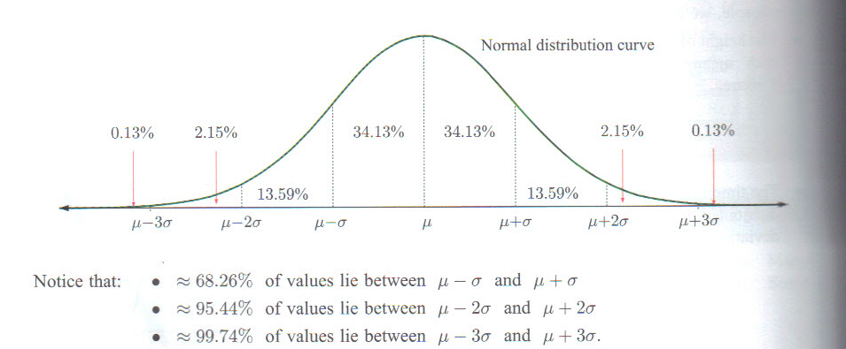
The Normal Distribution Curve
Bell Shape
Exact location and shape of curve determined by mean and standard deviation.

Slide 4
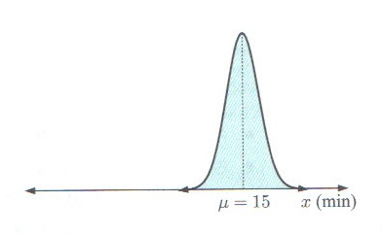
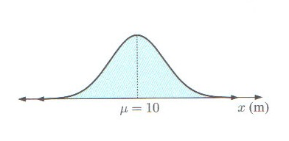
Examples Normal curves always symmetric about $x=μ$
Height of trees
Time it takes Sean to get to school
Mean = 10 m
Standard deviation = 3
Mean = 15 min.
Standard deviation = 1 min

Slide 5
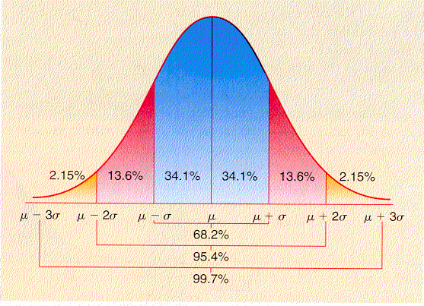
$$X\sim N(μ,σ^{2})$$
X is continuous variable that is normally distributed with mean $μ$ and standard deviation $σ$.

Slide 6
Example
The chest measurements of 18 year old male footballers are normally distributed with a mean of 95 cm and a standard deviation of 8 cm.
Find the percentage of footballers with chest measurements between:
87 cm and 103 cm
103 cm and 111 cm
Find the probability that the chest measurement of randomly chosen footballer is between 87 cm and 111 cm.

Slide 7
Assignment
P.303 #1-9 odd

Slide 8
10B TLW finding probabilities with a normal curve and the GDC.
$X\sim N\left(10,{2.3}^{2}\right)$ means that X is normally distributed around the mean of 10 and the standard deviation is 2.3.
How do we find P($8≤X≤11)$?
Probability of a value between and including 8 and 11.

Slide 9
Example
If $X\sim N(10, {2.3}^{2})$, find these probabilities:
$P(8≤X≤11)$
P(X$≤$ 12)
P(X>9)
*for continuous distributions, P(X>9) = P(X$≤$9)
Using your GDC!
Press 2nd VARS
Choose 2: normalcdf(
Normalcdf(lower, upper, mean, s.d.)
OR
Normalcdf(very small #, upper, mean, s.d.)
OR
Normalcdf(lower, very large #, mean, s.d.)

Slide 10
Example
In 1972 the heights of rugby players were approximately normally distributed with mean 179 cm and standard deviation 7 cm. Find the probability that a randomly selected player in 1872 was:
At least 175 cm tall
Between 170 cm and 190 cm

Slide 11
Assignment
P. 307 #1-9 odd

Slide 12
10C TLW apply quantiles or k-values.
A population of crabs have a length of shell, X mm, is normally distributed with mean 70 mm and standard deviation 10 mm.
A biologist wants to protect the population by allowing only the largest 5% of crabs to be harvested. He therefore asks the question: “95% of the crabs have lengths less than what?”
This is the opposite of what we’ve been finding
$P\left(X≤k\right)=.95$

Slide 13
Quantile
This unknown k is a quantile
In the case of the crabs the 95% quantile
This is the inverse of finding the probability
Use the inverse normal function on GDC
We find the values to the left of the k value. If it asks for information to the right then we find the difference of 1 and the asked value.

Slide 14
Example
If $X\sim N(23.6, {3.1}^{2})$, find k for which P(X < k) = 0.95
Press 2nd VARS
Choose invNorm(
invNorm(quantile, mean, s.d.)

Slide 15
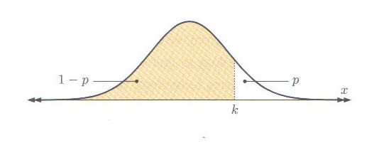
What does the answer mean?
We find the area left of k.
If $P\left(X≥k\right)=p$, then $P\left(X≤k\right)=1−p$

Slide 16
Example
A university professor determines that 80% of this year’s History candidates should pass the final examination. The examination results were approximately normally distributed with mean 62 and standard deviation 12. he lowest score necessary to pass the examination.

Slide 17
Assignment
P. 309 #1-9 odds

