Slide 1
Chapter 1
A: The learner will interpret words used in mathematics.

Slide 2
Vocabulary
Would you agree that mathematics has its own language?
It becomes necessary to understand the vocabulary use in mathematics.
Digits: 0, 1, 2, 3, 4, 5, 6, 7, 8, 9
These create all decimal numbers.

Slide 3
Word Problem Vocabulary
Addition | Subtraction | Multiplication | Division
Sum | Difference | Product | Quotient
Altogether | Less | times
Increased by | Decreased by | Double, triple
More than | More than
Multiplication Vocabulary
Factors multiply to the product.
Division Vocabulary
Can’t divide by zero!

Slide 4
Example
Find the sum of 187, 369, and 13
Find the difference between 37 and 82.

Slide 5
Exercises
P.21-22 #1-11

Slide 6
Lesson 1F Goal: TLW identify number sets.
Natural/Counting Numbers, $ℕ$: 0, 1, 2,3, 4, …
Integers, $ℤ$: $0, ±1, ±2, ±3, …$
Rational, $ℚ$: any number that can be written as a fraction; $\frac{p}{q}, q≠0$
Includes terminating and repeating decimals
$\frac{4}{1}=4$, .25, $.\overline{3}$
Real $ℝ$: any number on a number line
Note: “+” symbol means positive numbers only
$$ℝ$$
$$ℚ$$
$$ℤ$$
$$ℕ$$

Slide 7
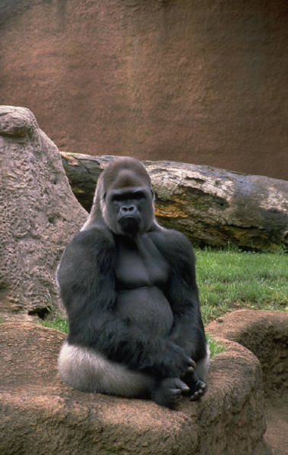
Examples
Why is any positive integer also a rational number?
Why is -7 a rational number?
Hmmm.

Slide 8
Show they are rational
0.47
0.135

Slide 9
Show the following are rational
Set decimal equal to x.
Multiply by a power of 10 to move the repeating part in front of the decimal. It’s an equation, so both sides.
Subtract original equation from new equation.
Solve for x.
0.77777……

Slide 10
Once more for the children…
0.363636…

Slide 11
Not for Spock.
Irrational Numbers, $ℚ$:
Cannot be written as $\frac{p}{q}, q≠0$
Non repeating, non terminating decimals
$π, \sqrt{3}, \sqrt{11}$

Slide 12
Assignment
1F.1 p 34 #1-6
1F.2 p. 35 #1-3

